Slide 1
SURVIVING 100K
SUBSCRIBERS:
Payment economics that determine
MVNO survival
Todd Curry, CEO, Vesta | MVNO Nation Live Americas | April 28, 2026
Notes:
Quick intro: 30 years telecom payments, processing $5.2B annually for carriers worldwide. Today: I’ll show you innovations that are changing how smart MVNOs think about payments.

Slide 2
Launching an MVNO has never been easier. Surviving—and thriving—is hard.
The first 10k subscribers prove demand.
The first 100k subscribers prove whether you have a viable business.
What breaks at scale:
Small approval gaps = millions in lost revenue
Fraud shifts from nuisance to margin threat
Manual processes collapse under volume
What looked like momentum becomes margin compression
Notes:
Anyone can launch an MVNO today. Telco-in-a-box platforms, eSIM onboarding, and wholesale access have made entry easier than ever. But the real test doesn’t show up at launch. It shows up when growth hits scale and small percentage differences in key metrics have a large impact.

Slide 3
How a 2-point approval gap becomes millions in lost revenue.
Your target: 100k subscribers at $50/month = $5M in revenue
But what if your approval rate is 85% instead of 87%?
You're only capturing: $4,250,000 instead of $4,350,000
The invisible loss = $1.2M annually
Most MVNOs don't even track this number.
$1.2M
annually
Notes:
Let me show you exactly what I mean by "approval rates matter.” At 85%, you're capturing $4.25 million of that $5 million. At 87%, you're capturing $4.35 million.
The difference? A hundred thousand dollars. Every. Single. Month. That's $1.2 million annually in revenue you're leaving on the table. Not because you have bad customers. Not because they can't afford it. But because your payment infrastructure is declining legitimate transactions. Most MVNOs don't even know this is happening. They track CAC, they track ARPU, they track churn. They don't realize they have a 15% decline rate—and a meaningful chunk of those declines shouldn't be happening. This is invisible revenue loss. And at scale, it's real money.

Slide 4
Fraud: your margin under attack
How fraud changes at scale:
  At 10K: Isolated incidents, manageable manually
  At 100K: Organized attacks, AI-powered fraud, patterns you can't spot manually
Telecom fraud ≠ Ecommerce fraud:
IRSF, SIM swap attacks, device reselling, chargeback fraud
VISA VAMP is raising the stakes:
April 2026: Penalties are doubling and the chargeback threshold drops
Notes:
We're seeing AI-generated synthetic identities, SIM swap attacks targeting premium plans and expensive handsets, device reselling schemes. This isn't amateur hour anymore.
And here's the critical difference: telecom fraud doesn't look like ecommerce fraud. Generic processors are trained on ecommerce patterns—unusual shipping addresses, weird purchase combinations. But in telecom, a prepaid customer topping up from different cities every week might be a truck driver, not a fraudster. Someone buying three lines at once might be getting phones for their family, not running a scheme. You need fraud models built specifically for telecom.

Slide 5
Common payment challenges from MVNOs as they scale
Approval
rates start
to drop
Manual fraud
rules break as transaction
volume grows
Chargeback management becomes costly
and resource-intensive

Slide 6

Meanwhile, you're stuck with one processor's limitations.
Single acquirer = single point of failure
If they have issues, your transactions stop.
No backup when they tighten risk controls.
Dependent on one bank's approval algorithms.
One processor can't optimize for every transaction
Different banks excel at different transaction types.
International cards vs. domestic patterns.
Bank A declines what Bank B would approve.
Notes:
Here's another problem: many MVNOs are stuck with a single processor. If that processor has technical issues, or decides to tighten their risk controls, or just isn't optimized for your transaction patterns—you're out of luck. Different banks have different strengths. One might be great with international cards, another with prepaid patterns. When you're locked into one, you're missing approvals you could be getting. And if they go down or freeze your account? Your business stops. The good news is: we're here to help with multi-acquirer routing that maximizes approvals and eliminates that single point of failure.

Slide 7
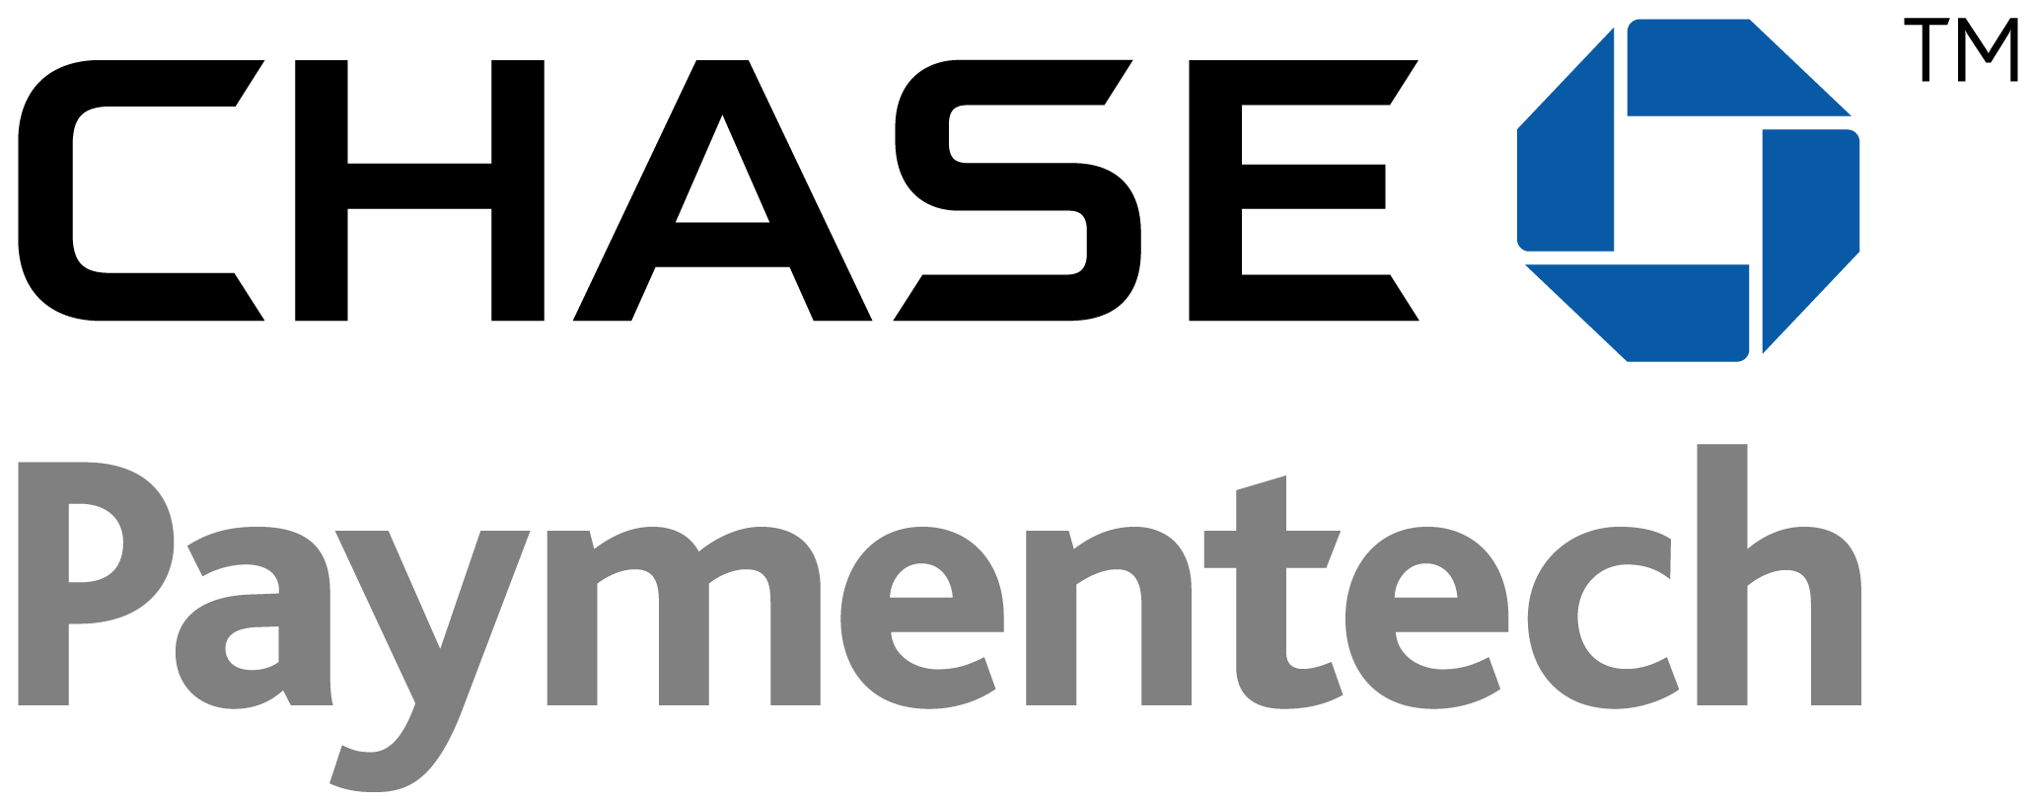

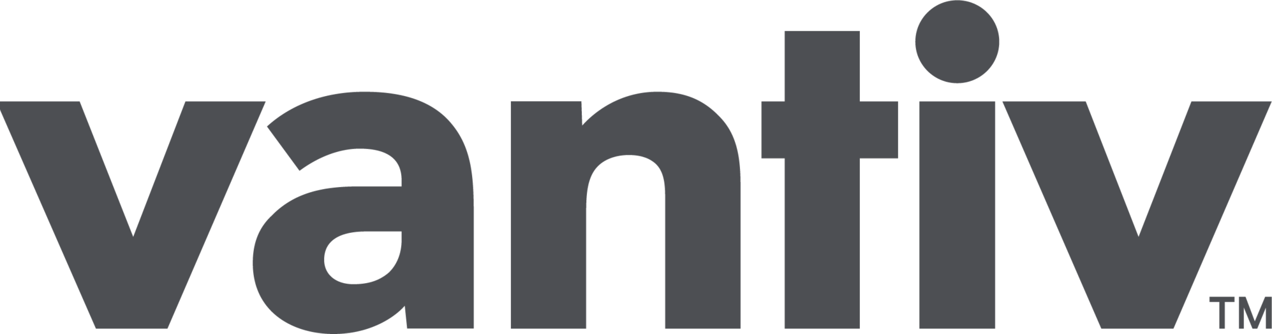
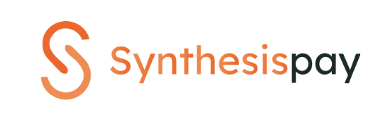

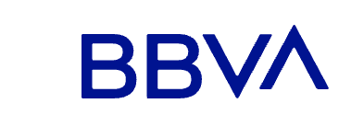





There are solutions.
Work with a payments partner who has multiple acquirers.
Look for partners with intelligent routing.
Choose a partner with telecom expertise.
Calculate total cost of ownership, including approval rates, fraud protection, customer service, and business continuity.
Prioritize the customer experience.
Notes:
So what should you look for in a payment partner?
Multiple processors: Not just for redundancy—different banks excel at different transaction types. One might be great with international cards, another with prepaid patterns. You need options.
Intelligent routing: When a transaction fails at one processor, can your partner automatically retry it somewhere else in milliseconds? That's what turns multiple connections into actual revenue.
Telecom expertise: Generic processors don't understand your business. They don't know that a prepaid top-up has different risk than a device purchase.
Total cost of ownership: Not just processing rates. What's the cost of a 15% decline rate? What's the cost when your single processor goes down? Factor in approval rates, fraud protection, and business continuity.
Customer experience: When payments work smoothly, customers stay longer. Your payment infrastructure is a retention tool and a revenue engine.

Slide 8
Rely on an expert to handle fraud and chargebacks
E-commerce fraud expertise ≠ telecom fraud expertise
Avoid the risk of account freezes or shutdowns
Outsource chargeback management to focus your team on growth

Slide 9

Turn payment "stop signs" into "traffic circles."
When payments fail, Roundabout creates options:
Intelligent retries through
different processors
Partial payment acceptance
Downsells
You set the rules; Vesta does
the work.
Patent-pending. Game-changing.
Watch video
Notes:
Especially valuable for customers on fixed incomes. Instead of hard "no," you control what to accept. Reduce churn and improve your customer experience. You set the rules, and we handle the rest. [If video is ready, play 60-second explainer here]

Slide 10
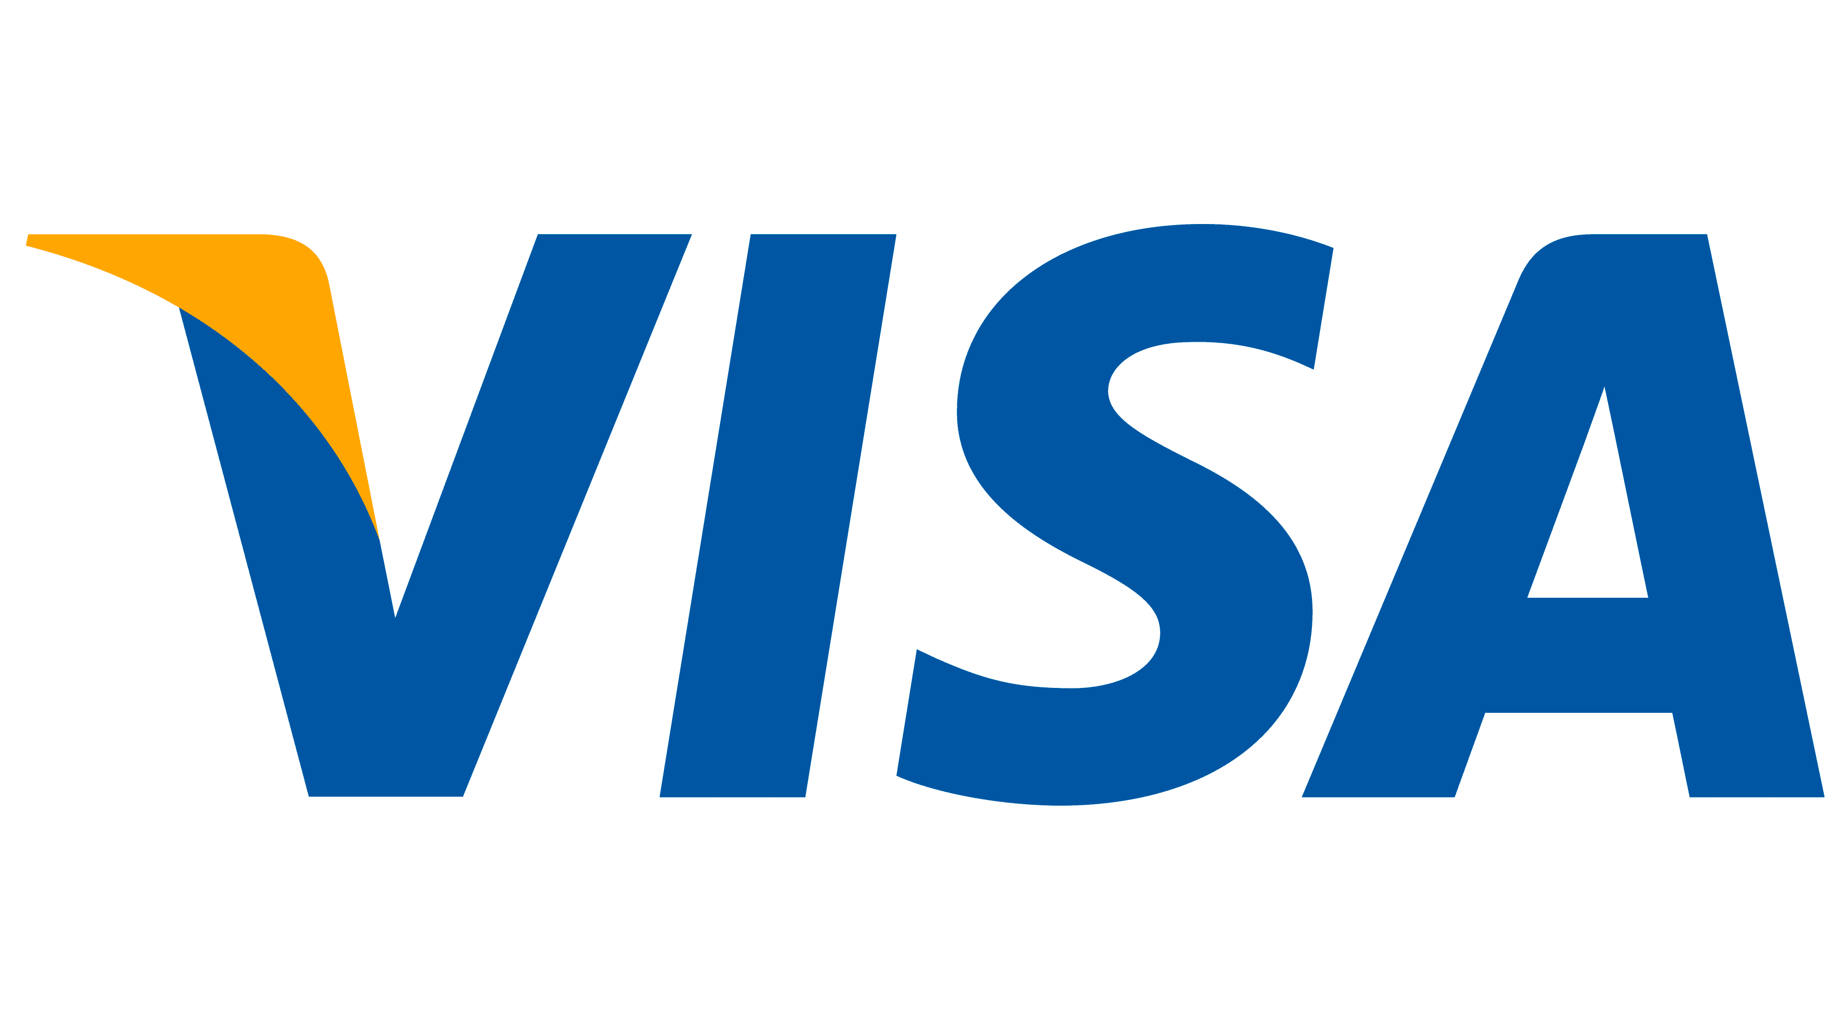









Offer your customers multiple payment
methods.
Credit & debit cards
Digital wallets (PayPal, Apple Pay, Google Pay)
ACH & eChecks
Local payment methods
Cryptocurrency
Single integration. Complete reconciliation. One partner.
Notes:
Payment innovation isn't just about cards. Your customers want options. We handle everything from traditional cards to digital wallets to regional payment methods. Single integration, we reconcile everything. And yes, crypto is coming for prepaid later this year.

Slide 11
The 100k subscriber test: 5 diagnostic questions
Before you hit 100K, you should be able to answer:
What's your approval rate by channel? (Not just overall)
How is your fraud rate trending? (Stable or accelerating?)
What operational processes are manual? (Fraud rules, disputes, reconciliation)
Do you have processor redundancy? (What if your acquirer goes down?)
What's your payment failure recovery strategy? (Or are declined customers just... gone?)
If you can't answer these, scale will expose the gaps.
Notes:
So here's the framework I promised. Five questions every MVNO should be able to answer before hitting 100,000 subscribers—and definitely after.

Slide 12

Ready to stress-test your
payment economics?
Visit us at Booth #16
Schedule a demo: sales@vesta.io
Visit us at vesta.io
Notes:
Happy to answer questions. Come by our booth for a deeper dive on analytics, see Roundabout in action, or just talk about what you're seeing in your business. We love talking about this stuff.

