Slide 1




Touch Mobile
2026
Connecting
Every
Community
Affordable. Digital. Empowering.

Slide 2
Touch Mobile
23 December, 2027
The South African Connectivity Challenge
Digital Divide & Exclusion
High Costs & Low Access
Churn & Infrastructure Gaps
67 million people, with 45% living in rural areas. Limited digital infrastructure leaves millions without reliable connectivity, deepening the digital divide across communities.
South Africa has some of the highest data costs globally. Low smartphone penetration and poor broadband reach prevent underserved populations from accessing digital opportunities.
Mobile network churn rates of 10–20% reflect poor service quality and unaffordable pricing. Inadequate infrastructure in townships and rural areas continues to exclude millions.

Slide 3
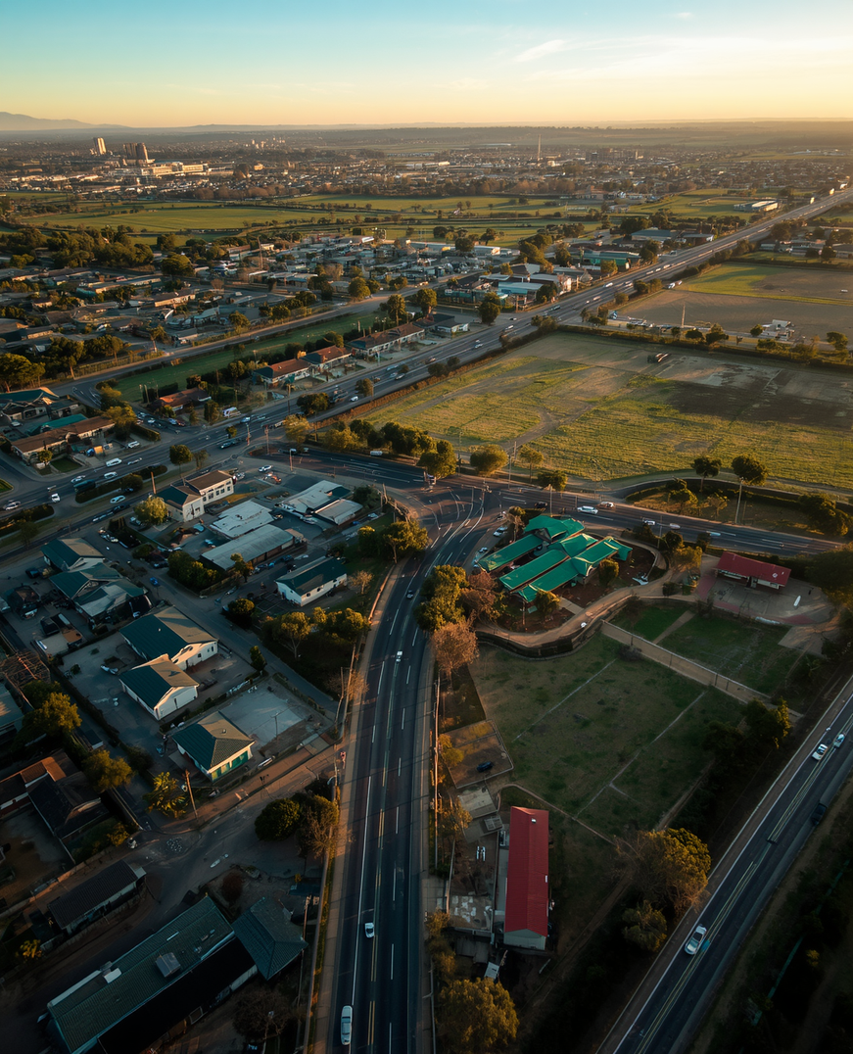


Touch Mobile
23 December, 2027
The SA Connect Opportunity
SA Connect's national initiative targets universal connectivity by 2030, creating a transformative opportunity for digital inclusion across schools, health facilities, businesses, and underserved communities throughout South Africa.
Universal Access by 2030
Government & Private Sector
Touch Mobile as Key Enabler
SA Connect targets schools, health facilities, SMEs, and communities — bridging the digital divide for 67 million South Africans with affordable, reliable connectivity.
Strategic collaboration between government bodies and private sector MVNOs accelerates infrastructure rollout and drives digital inclusion at scale across all provinces.
Touch Mobile is uniquely positioned as a community-first MVNO to deliver affordable digital services, empowering underserved populations and fulfilling SA Connect's 2030 vision.

Slide 4

Touch Mobile
23 December, 2027
Introducing Touch Mobile
01
Affordable data, voice & SMS
South Africa's first digital inclusion MVNO, built to bridge the connectivity gap. Touch Mobile delivers affordable data, voice and SMS with simple, transparent pricing — empowering communities through a fully digital, self-service platform.
02
Digital onboarding & self-service
03
Community empowerment focus
Digital-first. Community-first. Designed for every South African who deserves affordable, reliable connectivity.

Slide 5
Touch Mobile
05
Our Product Portfolio
Data Bundles
Voice, SMS & SIM
Value-Added Services
Flexible, affordable data packages designed for every budget. Daily, weekly, and monthly bundles with no hidden fees — keeping communities connected at the lowest cost.
Competitive voice and SMS plans with transparent pricing. Available on both eSIM and physical SIM, enabling seamless digital onboarding or traditional activation for all users.
Airtime top-up, digital content access, and self-service tools via app and USSD. Empowering customers with easy account management and premium digital experiences.

Slide 6


Touch Mobile
23 December, 2027
Our Brand
in Action
"Connecting. Engaging. Empowering."
"Touch Mobile changed how I stay connected with my community." — Lerato, Soweto
"Affordable data that finally works for us." — Sipho, Eastern Cape
Diverse South Africans trust Touch Mobile for reliable, affordable connectivity that uplifts communities and bridges the digital divide every day.

Slide 7


Touch Mobile
23 December, 2027
Technology
MNO & Infrastructure Partnerships
& Platform
Cloud-Based Customer Management
Self-Service App & USSD Access
Touch Mobile is built on a secure, scalable, and future-ready digital infrastructure. Strategic MNO partnerships ensure nationwide coverage, while our modern billing platform and cloud-based systems enable seamless service delivery. Our self-service app and USSD interface guarantee accessibility for every South African, regardless of device or connectivity level.

Slide 8

Touch Mobile
23 December, 2027
Market Opportunity & Key Targets
South Africa presents one of the most compelling mobile connectivity opportunities on the continent — with millions of underserved, mobile-ready customers and strong government-backed digital inclusion mandates driving demand.
Mobile Usage & Penetration
Smartphone Growth Outlook
Addressable Market Size
95% mobile phone usage across South Africa. 40M+ potential customers in underserved communities. 600,000 NSFAS-funded students as a key priority segment.
70% smartphone penetration projected by 2026. Rapid adoption of data-first devices across youth and low-income segments, fuelling demand for affordable connectivity.
Target: 50,000+ subscribers in Year 1. R110m+ cumulative revenue over 3 years. 2.5% ARPU growth target with clear path to profitability.

Slide 9

Touch Mobile
23 December, 2027
Growth Strategy & Revenue Model
01
Data, Voice, SMS & Value-Added Services
Touch Mobile drives revenue through diversified streams — data bundles, voice, SMS, and value-added digital services. Affordable, volume-led pricing builds loyalty and accelerates subscriber growth toward 50,000+ users in year one.
02
Volume Pricing & Customer Loyalty
03
ARPU Target & Profitability Timeline
A 2.5% ARPU target anchors our profitability roadmap, with R110m+ revenue projected over 3 years and a clear path to sustainable growth.

Slide 10

Touch Mobile
23 December, 2027
Customer
Digital-first onboarding
Acquisition
Community & referral programs
Loyalty & retention drivers
Touch Mobile acquires customers through app and USSD onboarding, making sign-up seamless for all users. Grassroots community partnerships and NGO collaboration drive organic growth. Referral incentives and loyalty rewards build long-term retention, while competitive pricing and reliable service reinforce trust and reduce churn across underserved communities.

Slide 11

Touch Mobile
23 December, 2027
Competitive
Community-first positioning
Advantage
Strategic NGO & MNO partnerships
Low-cost digital-native model
Touch Mobile targets underserved segments ignored by large incumbents, building deep local trust through grassroots engagement. Our digital-native infrastructure keeps costs low while our social impact mission drives brand loyalty, regulatory goodwill, and long-term defensibility against traditional MNOs.

Slide 12

Touch Mobile
23 December, 2027
Partnership Opportunities
Network Partners & MNOs
NGOs & Community Groups
Government & Regulatory Bodies

Slide 13

Touch Mobile
13 December, 2027
Financial Outlook
Touch Mobile is positioned for strong, sustainable growth. Our financial projections reflect disciplined subscriber acquisition, diversified revenue streams, and a clear path to profitability — underpinned by South Africa's vast underserved connectivity market.
Subscriber Growth
Revenue Milestones
Profitability Timeline
50,000+ subscribers in Year 1, scaling to 300,000+ by Year 3. Targeting NSFAS students, rural communities, and underserved urban segments as primary growth drivers.
R110m+ cumulative revenue over 3 years. Multiple streams including data bundles, voice, SMS, and value-added digital services driving ARPU of 2.5% growth annually.
Break-even projected in Year 2 with full profitability by Year 3. Key KPIs: churn below 8%, ARPU growth 2.5%, NPS above 60, and operational cost efficiency through digital-native infrastructure.

Slide 14


Touch Mobile
14 / 16
Community
Connectivity Model
People-first infrastructure bridges the digital divide by bringing connectivity directly to underserved communities. Touch Mobile establishes community hubs and local support centers that foster grassroots engagement, digital literacy, and empowerment. Through education initiatives and accessible self-service tools, we equip South Africans with the skills and connectivity needed to thrive in a digital economy.

Slide 15

Touch Mobile
15 / 16
Why Invest & Partner with Us?
01
Large, growing addressable market with unmet needs
Touch Mobile addresses a 40M+ underserved market with a digital-first, community-driven model. Our scalable platform, strategic MNO and NGO partnerships, and social impact mission position us for sustainable growth — delivering both financial returns and measurable community transformation across South Africa.
02
Proven community-first model & scalable platform
03
Strong partnerships, social impact & sustainability
Targeting R110m+ revenue over 3 years with 50,000+ initial subscribers and a clear profitability roadmap.

Slide 16



Touch Mobile
23 December, 2027
Thank You
Let's connect South Africa to opportunity. We welcome investor relations and partnership inquiries — join us in bridging the digital divide and empowering every community.
invest@touchmobile.co.za
www.touchmobile.co.za

