Slide 1










Innovation
made in Brazil
How to thrive in highly competitive environments?

Slide 2






Summary
1
The Brazilian environment
2
Veek’s challenge
3
What we came up with...
4
Why we were able to do this

Slide 3

The Brazilian environment
1

Slide 4








The
Brazilian
environment
90M
80M
55M
VIVO
+ CLARO
+ TIM =
94% market
share
→ 182 MVNOs
→ 4M active
mobile lines
270 million
active mobile
lines in Brazil
Highly
concentrated
market

Slide 5
Veek’s
challenge
How to thrive in a market with low margins and great competitors?
2

Slide 6







01
02
03
BRANDING
NICHE
REGION

Slide 7















O plano
pesou?
Com Veek
freemium
você relaxa

Slide 8
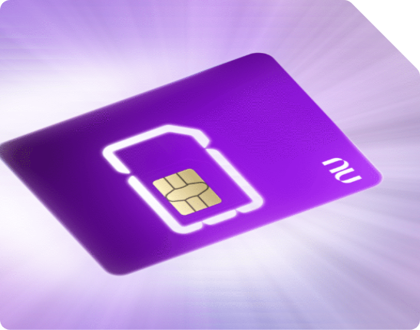
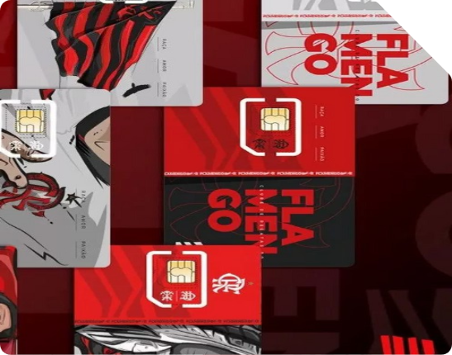



NICHEs
NUBANK
FLAMENGO
CORREIOS
DIGITAL BANK
SOCCER CLUB
POSTAL SERVICE

Slide 9
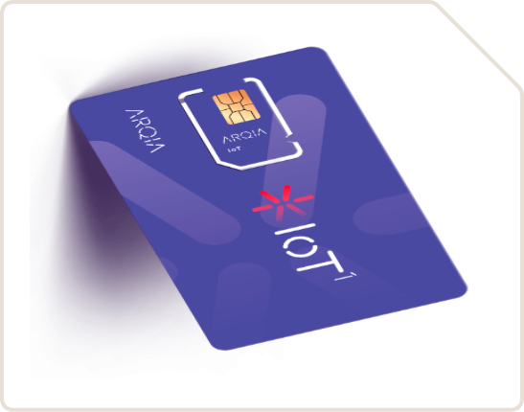
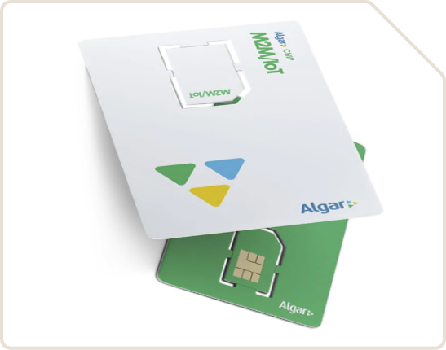

REGIONs
ARQIA
ALGAR
BRISANET
SÃO PAULO, SP
UBERLÂNDIA, MG
PEREIRO, CE

Slide 10

How to thrive?
INNOVATION

Slide 11
What we came up with...
3

Slide 12
What we
came up
with...
25% OF BRAZILIANS
own a cell phone but don't have money to add credit
60 MILLION
people in need for
DIGITAL INCLUSION
FREE
mobile
conectivity
→ GREAT PRODUCT DONE
→ Now what?
→ GO TO MARKET
→ We are done here?
Based on Spotify freemium we built an app for you to check in before you have the access to your voice and data services
→ Rewarded videos
→ Banners
→ Push messages
→ Research
We built a powerful communication tool

Slide 13

Once you deliver chips,
you have to
sell the ads

Slide 14
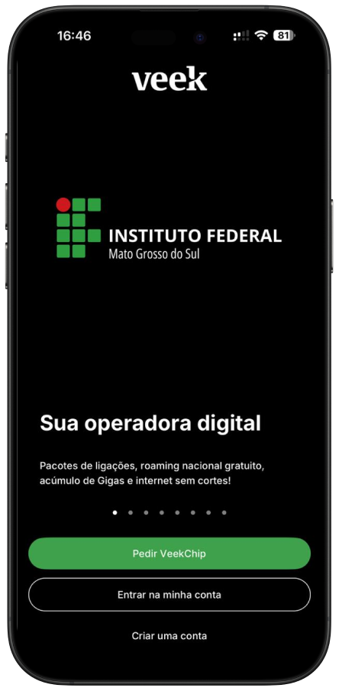



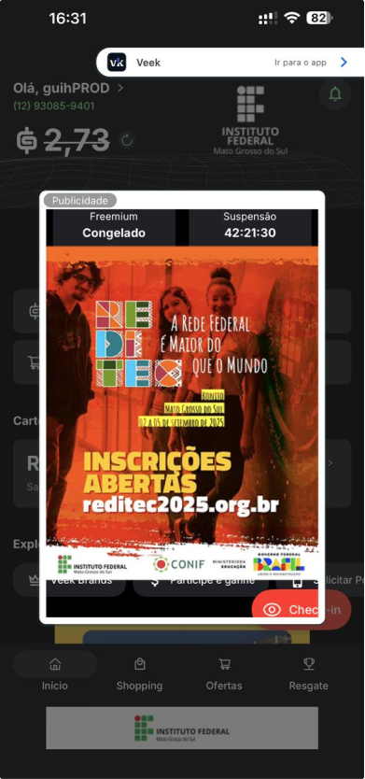

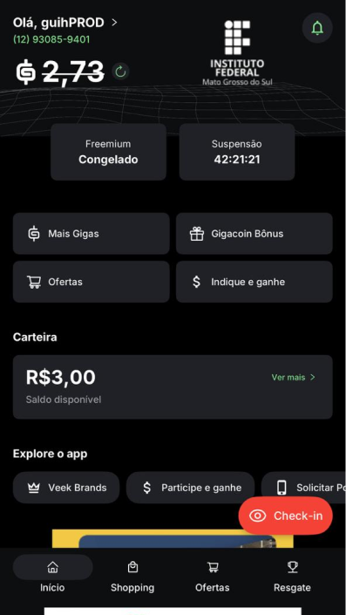



Slide 15
Why we were able to do this
4

Slide 16

Expertise in
hyper-competitive markets
Why we were able to do this
Performance
Operating in Brazil - one of the world’s most complex and bureaucratic telecom environments - has battle-tested Grupo Macro to succeed anywhere
For Brazil’s
largest MNOs
SOCIAL
SELLING
Live Data & “World class IA”
Sales-as-
-a-Service
CAC EFFICIENCY
We see behavior, trends, make decisions better and boost distributor’s performance
Brazil’s leaders in closing sales via WhatsAspp and social media
We manage
the entire sales force to guarantee the “close”
High-performance Sales Frameworks

Slide 17






THANK YOU!
veek.com.br

