Slide 1

`
Panel: Partnering with MVNOs beyond mobile – Fiber, fixed wireless and further afield

Slide 2
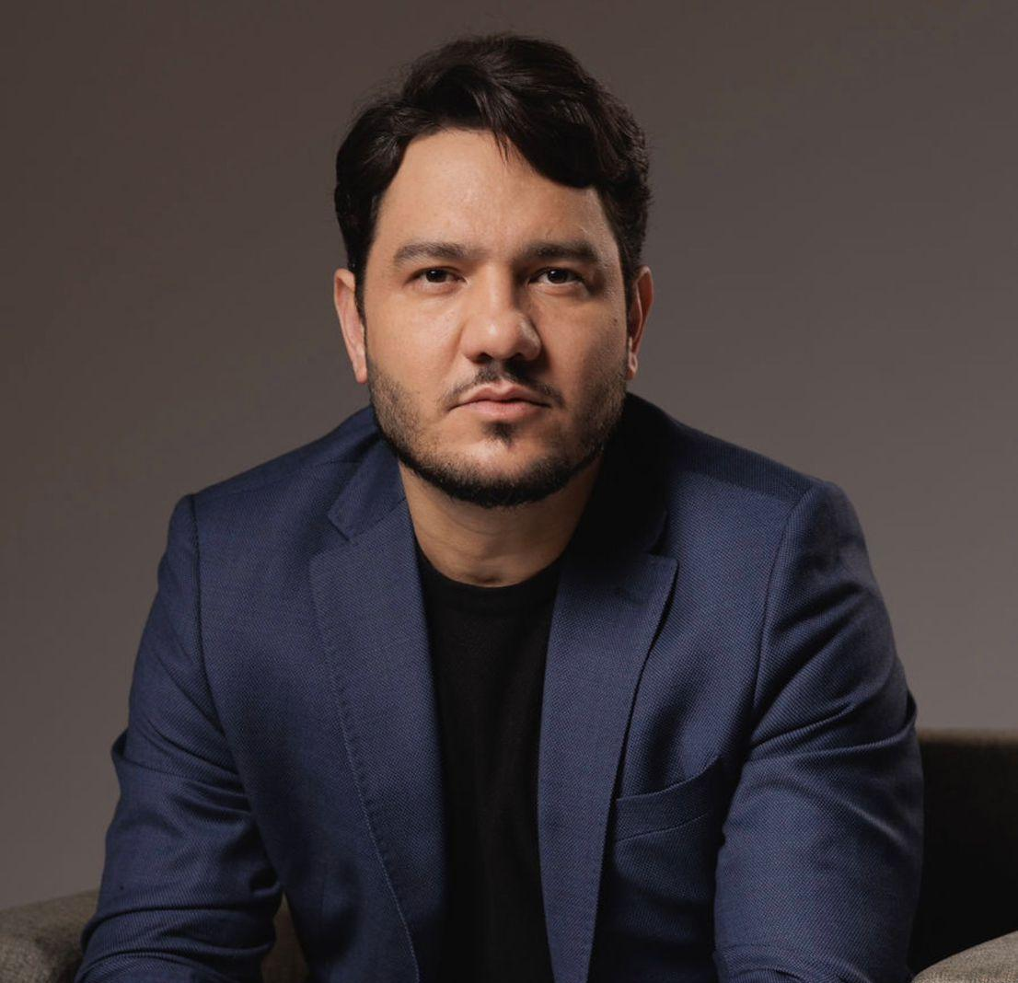
Laerte Magalhães CEO, iuh!

Slide 3
Internet to Unite and Humanize
How a Multi-Network VNO Platform is Helping Connect Brazil

Slide 4
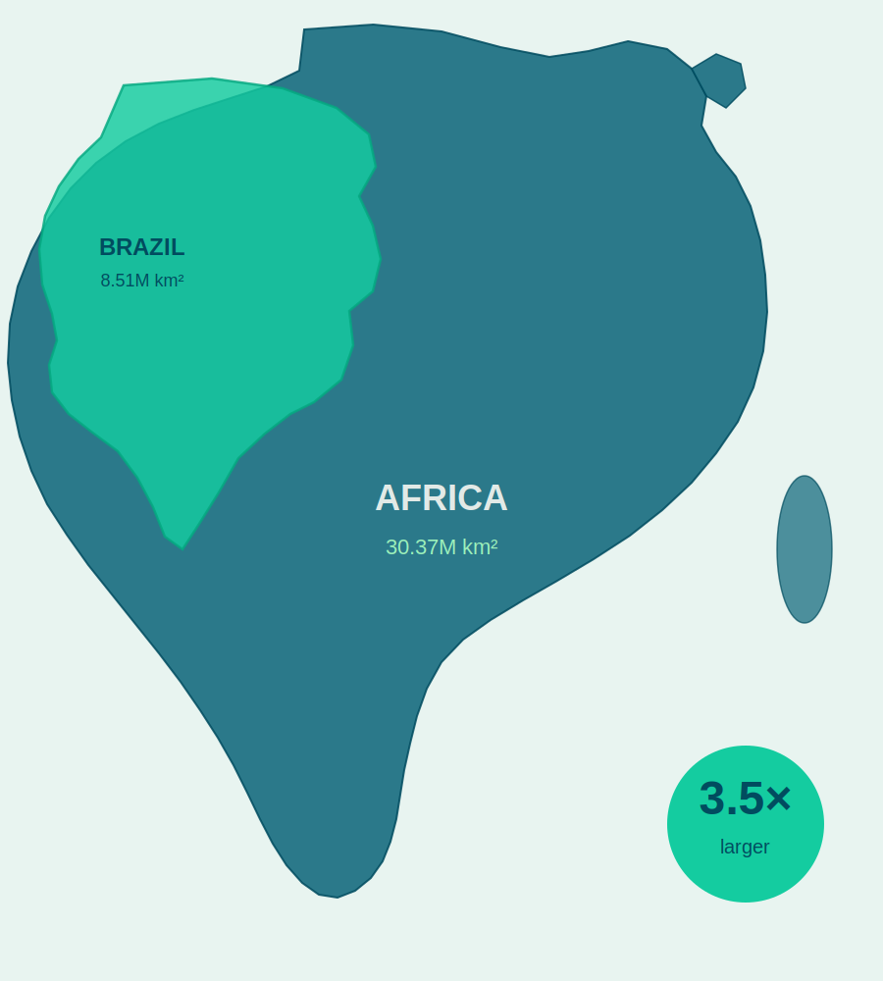

THE CHALLENGE
The challenge is not simply coverage.
The challenge is
connecting
people at scale.
140,000
schools in Brazil
30M
people without mobile internet
6M
people without coverage
Notes:
Brazil is a continental country — 8.5 million km². The entire African continent is 3.5 times larger. The scale challenge here is even greater — which is exactly why a multi-network orchestration approach matters.

Slide 5
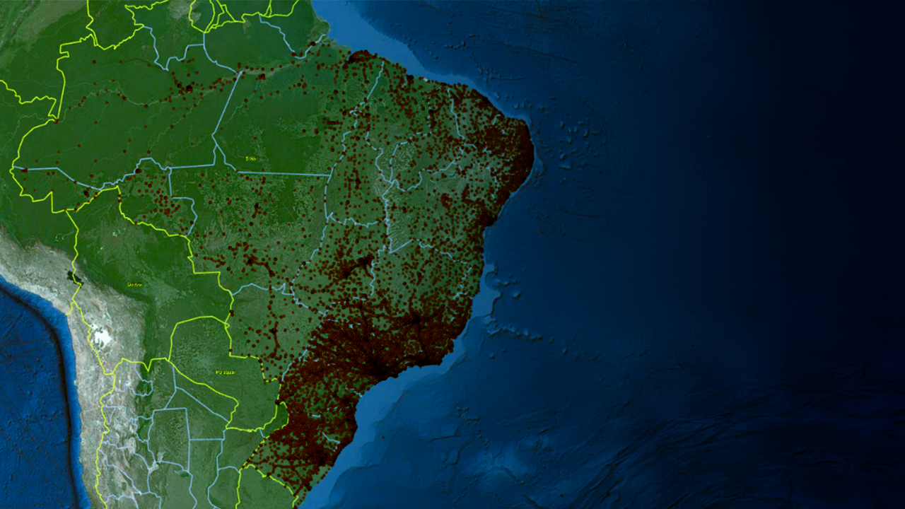
3 major carriers
110,000 mobile service towers.
However, with 864 localities and 6,500 km of highways without coverage.

Slide 6




IT IS NOT ONE TECHNOLOGY
Technology
follows the need
COMMUNITY
Fixe
Fiber / Radio
Mobile:
4G/5G, FWA
Satelite:
LEO / GEO
Not the other way around

Slide 7

We are a connectivity platform that brings the internet — with purpose — to those who need it most.
We connect thousands of locations across Brazil.
We orchestrate networks.
We do not compete with them.

Slide 8

Ecosystem of Partners
1,000+ Internet Service Providers (ISPs)
National and Regional Operators
Satellite Connectivity Providers
Technology and Equipment Vendors
Digital Service Platform

Slide 9
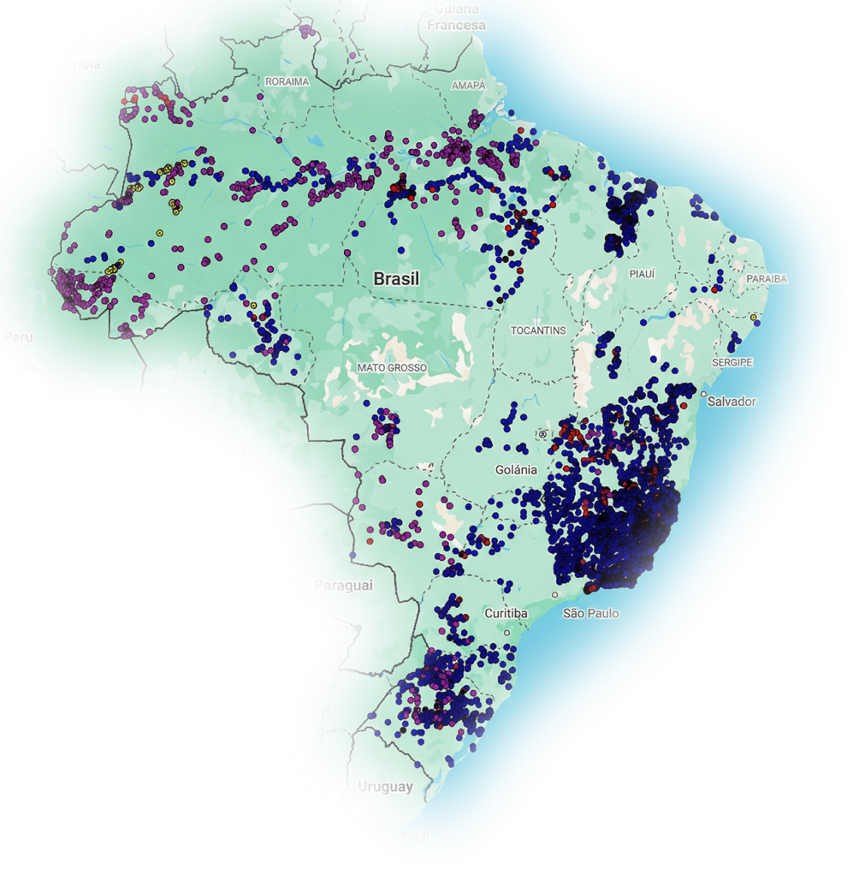

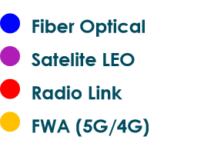
CONNECTIVITY CREATES INCLUSION
500K+
3M+
SIMs
Activated
Students
Connected
7k+
27
Distribuição da
tecnologia:
Connected
Sites
States
Covered
Mobile First. Fiber First. Satellite First.
At iuh!, we believe in something different.
Inclusion First.
iuh! | MVNO • MVNE • MVNA | iuh.digital

Slide 10
It’s not about technology beyond mobile...

Slide 11
It’s about connecting people, creating opportunities, and humanizing access to the digital world.

Slide 12

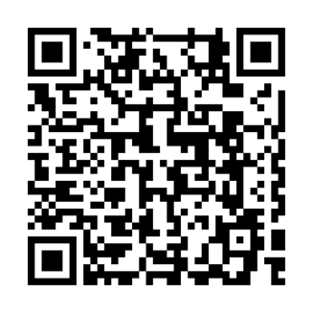

Internet
Unite
Humanize
Follow our journey.

