Slide 1



Powering the Growth of Value-Based MVNOs
How Circles and Vodacom are facilitating
the launch of next-gen MVNOs
Shenge Buthelezi
Managing Executive of Vodacom SA Wholesale
Sanjay Kaul
Chief Executive Officer, Circles Aspire BV
Chief Revenue Officer, Circles Group
© 2026 Circles
• AI-Powered Telco Transformation

Slide 2

Overview of how Vodacom and Circles have partnered to execute a value-creation-led MVNO enablement strategy
© 2026 Circles
• AI-Powered Telco Transformation

Slide 3
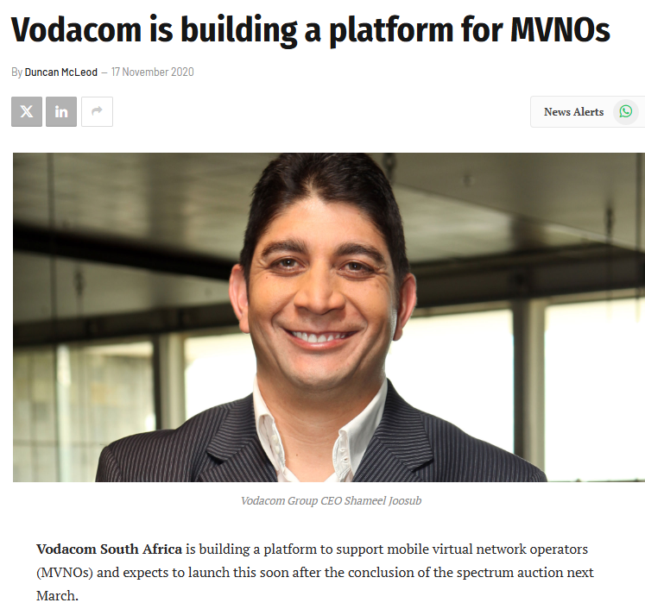
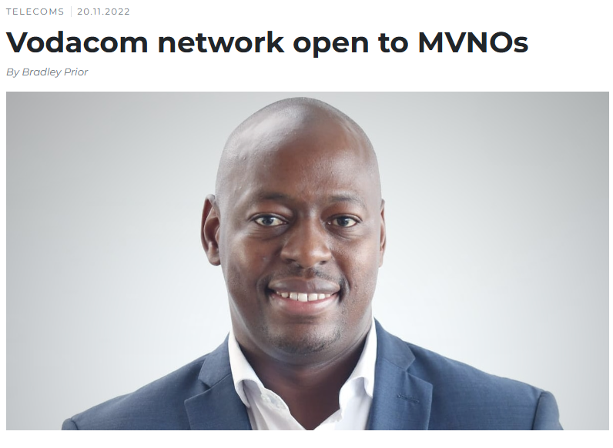

MVNO is a big part of our strategy| We’ve been executing
ITWeb , November 2020
MYBROADBAND, November 2022
Connecting Africa, Itweb, Business Day, MyBroadband September 2024
Articles
https://techcentral.co.za/vodacom-signs-its-first-mvno-customer/252119/
https://www.itweb.co.za/article/vodacom-outlines-mvno-enabler-growth-strategy/JBwErvn3Zkm76Db2
https://mybroadband.co.za/news/wireless/574062-whats-next-shenge-buthelezi-on-vodacom-signing-mr-price-mobile-as-its-first-mvno-partner.html
https://www.connectingafrica.com/investment/exclusive-vodacom-launches-first-mvno-in-house-mvne-service
https://mybroadband.co.za/news/cellular/615559-the-company-powering-vodacoms-mvno-drive.html

Slide 4
The MVNO Value Chain |
Vodacom & Circles with you at every point of the journey
Inputs
Outputs
Outcomes
Business Drivers
ATL Marketing
Sims Connected
Engagement
Profitability
Branch Visibility & Availability
Usage
Launch
Why US? (UVP)
ARPUs
Cross-selling & Upselling
Launch Incentives
First Recharge
Bundle Purchase
Primary SIM Behaviours
Overall Brand Stickiness
Sim & Distribution Costs

Slide 5


What the MVNO Wants| What Actually Happens | How we’re positioned to help
Desired Behaviour
Observed Behaviour
How Vodacom & Circles are Helping
Addressable MVNO Market Share
Convert ‘Core Business’ Customers into MVNO Customers
Slow conversion if there’s no Compelling Value Proposition
Sector specific value propositions
AI driven Hyper personalisation
Limit Costs to success based direct costs
Higher Usage (engagement) & Lower Sim costs
Higher Sim Costs less usage (Lower Engagement)
One stop shop for MVNE & MNO
Outcomes based charging,
Not driving the MVNE platform as a profit centre
Stickiness, days active, Engagement
First Recharge & Primary Sim Behaviour
Deplete loaded value, shelve or throw away the sim, revert to primary number
Behaviour based discounting
Buy & get
Your subscription is on us if you behave correctly
MVNO drives desired behaviours in the core business (Retail, Content) & becomes a profit centre of its own
MVNO remains a cost centre subsidised by the core business
Co-create a brand-fit and value-led MVNO
Execution partnership
Power of Vodacom distribution & Airtime, Devices, Economies of Scale
Sustainable & Value-led growth

Slide 6
VIDEO
© 2026 Circles
• AI-Powered Telco Transformation

Slide 7
Why do MVNOs succeed when they focus on differentiation, experience & personalisation, rather than commodity data?
© 2026 Circles
• AI-Powered Telco Transformation

Slide 8



The Future of MVNOs:
Ecosystem Utility and Context Monetization
Differentiation
Experience
Personalization
Successful MVNOs operate as non-telco vertical brands
Frictionless onboarding drives adoption
AI-driven personalization as baseline requirement
Connectivity is a hook to pull users to a wider ecosystem (e.g. Fintech)
Convenience is the new currency. MVNOs must replace friction with convenience.
AI-powered personalization can boost acquisition and revenue by automating cross-selling and reducing churn
© 2026 Circles
• AI-Powered Telco Transformation
Notes:
MNOs have structural advantage in commodity data “price war”. MNOs buy data capacity at cost, whereas MVNOs buy it at a wholesale markup. MNOs can always undercut MVNOs to protect their market share. Thus, the future of the MVNO is not telecom, it is ecosystem utility and context monetization.
Differentiation:
Most successful MVNOs do not view themselves as telecom companies. They view themselves as non-telco vertical brands that distribute connectivity, using telecom as a hook to pull users into a wider ecosystem. E.g. Fintech brands integrated connectivity into banking rewards.
Experience:
Frictionless onboarding drives adoption. Globally, digital-only MVNO brands grew by 48% and 50% of all new activations happen through digital channels. Convenience is the new currency, MVNOs must replace friction with experience.
Personalisation:
AI-driven personalization has become baseline operational requirement. MVNOs implementing AI-powered personalization achieve doubled acquisition rates and revenue boosts by automating cross-selling and preventing churn.

Slide 9

How does bundled services deliver better margins & stickiness, leading to long term loyalty & ARPU growth

Slide 10




Bundle the Pipe with the Product
"Ecosystem and bundle play" - A universally proven framework used by the world’s most profitable virtual operators
The Pattern Is Consistent Across Leading MVNOs
Bundled data with groceries and drove churn down to historic lows
Bundled multi-month commitments to kill monthly churn entirely
Bundled connectivity with remittance to capture the global diaspora
Bundled connectivity with services targeted at seniors and retirees
"When we look globally, the MVNOs that survive and dominate are never the ones selling the cheapest megabytes. Data is just the pipe. The financial loyalty, the retail rewards, the localized community utility—that is the product. If you bundle the pipe with the product, the margins and the stickiness will take care of themselves."
© 2026 Circles
• AI-Powered Telco Transformation
Notes:
"Ecosystem and bundle play" isn't just an experimental regional trend—it is a universally proven framework used by the world’s most profitable virtual operators to escape the commodity data trap.

Slide 11

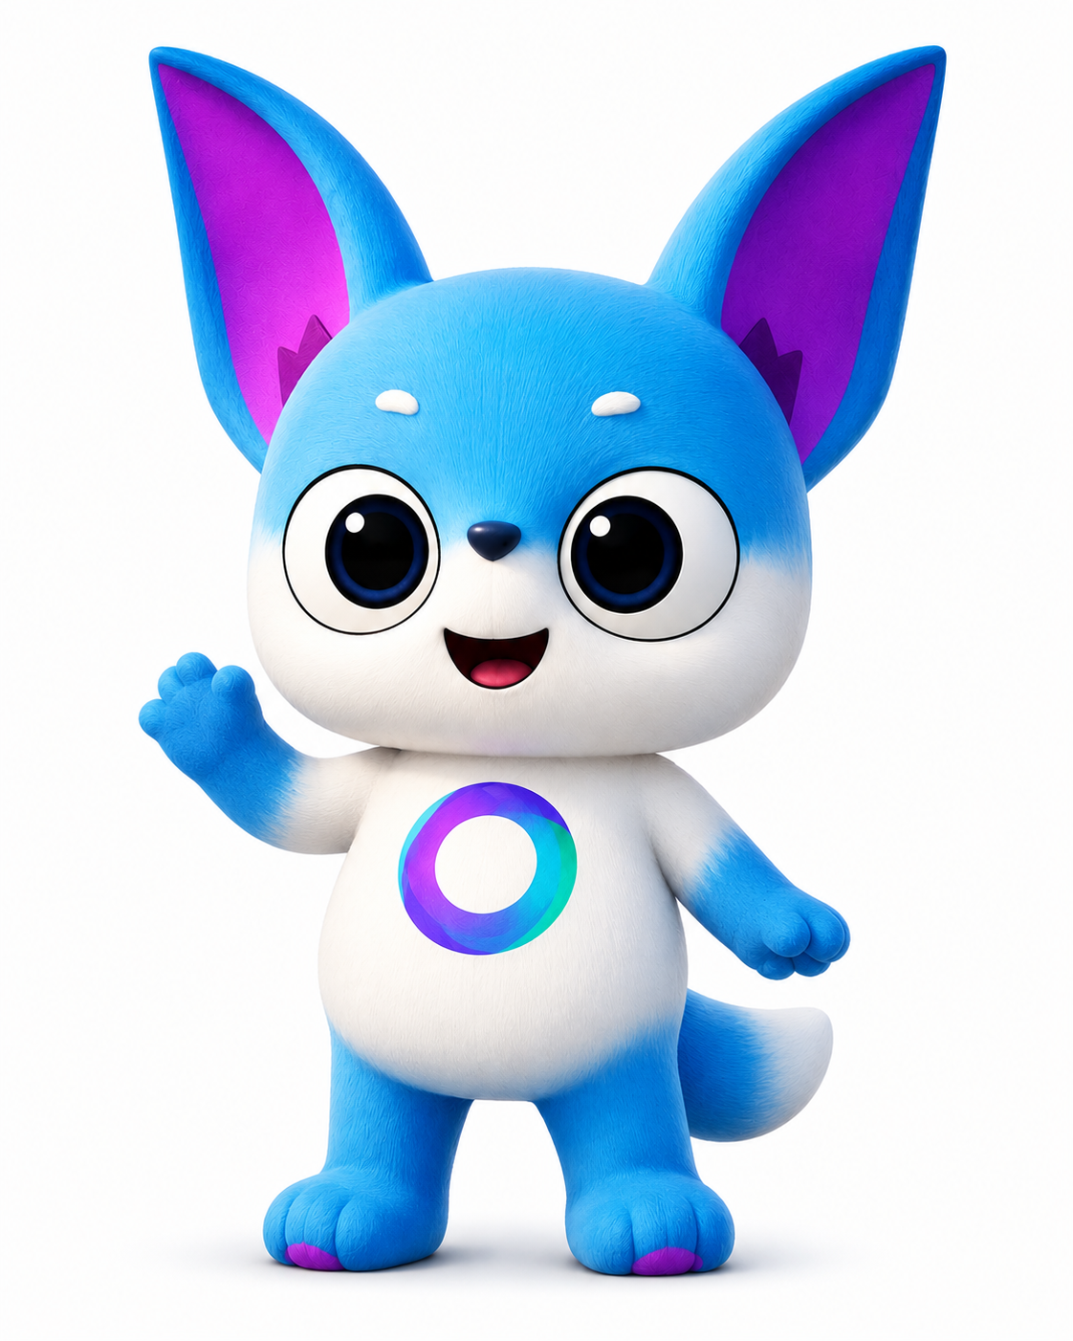



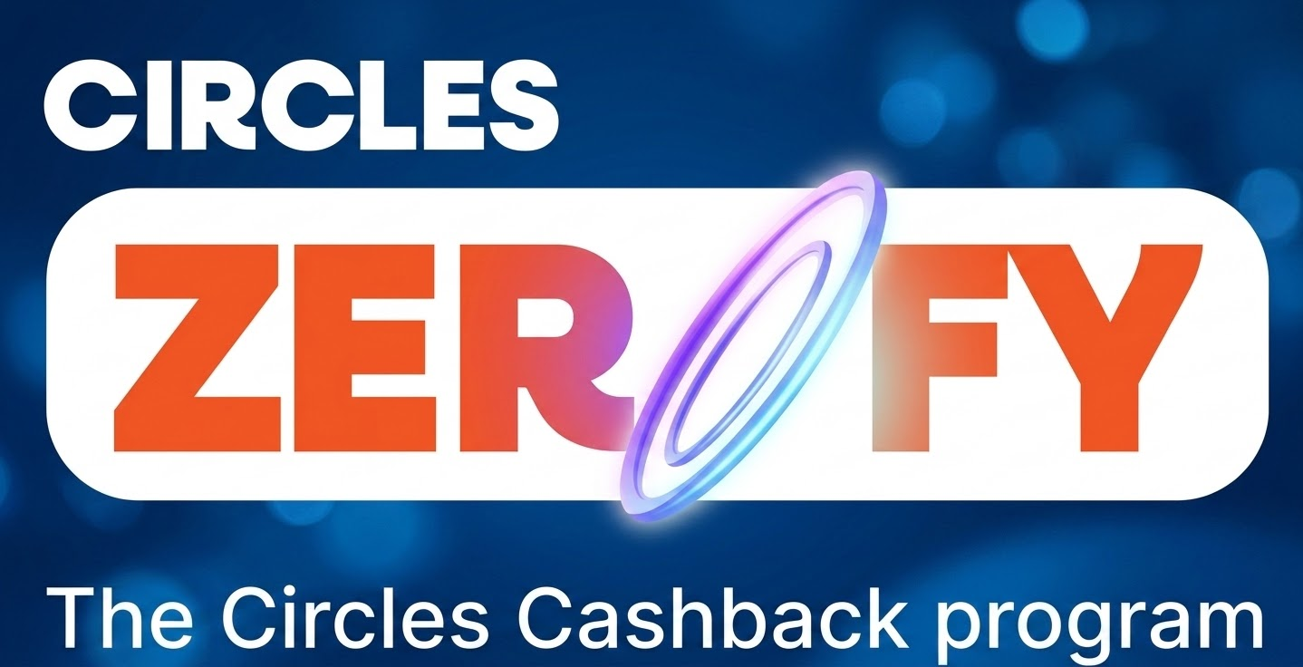


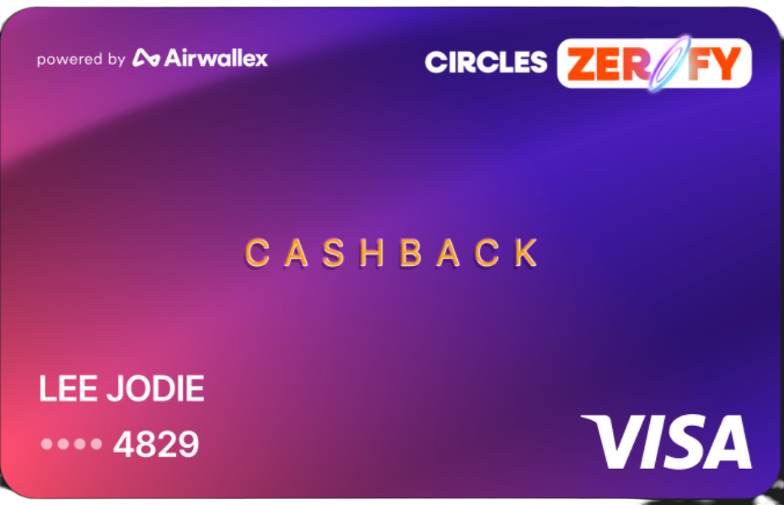

Circles.Life - Singapore Story
We Bring Innovation
With Real Commercial Outcomes
Free Access to the best
AI models
60+ NPS
Zerofy Users vs Baseline
15%
ARPU Uplift from Innovation
The best deals at your favourite merchants
A VISA debit card giving cashback on daily spend
5x
LTV/CAC vs Telco Only Users
20%
Lower Churn Rate
© 2026 Circles
• AI-Powered Telco Transformation

Slide 12

Why should MVNOs embrace GenAI capabilities
for more intuitive mobile experiences that
feel premium at budget-friendly prices?
Notes:
Header – 44
Subhead – 36

Slide 13




Premium CX at Budget Prices: Why GenAI?
Premium
Customer Care
Hyper-
Personalization
Frictionless Onboarding
Marketing Force Multiplier
AI Agents resolve complex queries
Automate support at scale
Predictive plan optimization and dynamic churn prevention for every subscriber.
Conversational eSIM activation and instant localization for niche expat segments.
Launch targeted campaigns in minutes, matching major carrier department outputs.
70% Self-Service
+15% ARPU
-30% Support Calls
4x Agility
Traditional premium carriers spend millions on massive call centers to provide top-tier support. MVNOs simply don't have that budget.
Premium experiences are defined by how well a brand knows its customer.
The digital app is an MVNO's storefront. GenAI streamlines the entire onboarding process, making it feel sleek and futuristic.
Major telecom brands have massive marketing departments. MVNOs typically run on lean, skeleton teams.

Slide 14





Circles’ MAXIM
MAXIM (Multi AI eXperience, Intelligence & Monetization) introduces a new operating model for operators.
One that is AI-native, composable, and continuously connected.
At the core of MAXIM are
composable interoperable modules
Agentic customer service that resolves queries end-to-end via BSS/OSS actions
Real-time decision intelligence with governed, explainable insights
Contextual gratification engine drives timely, personalized subscriber engagement
Unified AI concierge connecting customer experience, operations, and revenue intelligence

Slide 15
Vodacom and Circles commitment to being long-term strategic partners to MVNOs - delivering co-innovation and shared success for sustained growth
Notes:
Header – 44
Subhead – 36

Slide 16


Vodacom MVNO | What’s Next
1
What it is: Service provider pays so customers can access specific content or services without using their own data.
Value to MVNO: drives customer acquisition and engagements while unlocking revenue through partnerships with content and service providers.
Sponsored Data
2
Telco APIs
What it is: Generation of revenue by exposing services or capabilities through APIs for 3rd parties to use at cost
Value to MVNO: enables new digital revenue streams, differentiated offerings and scaling services at speed
3
What it is: Data-driven, automated marketing campaigns across the customer lifecycle to drive engagement and retention.
Value to MVNO: Increases ARPU and reduces churn through personalised, targeted offers
CVM Campaigning
4
What it is: SMS messaging with a branded sender ID instead of a numeric code
Value to MVNO: Enhances trust, improves engagement rates, and strengthens brand visibility
Branded Messaging

Slide 17
Vodacom MVNO | What’s Next
5
Engagement App
What it is: A digital self-service and engagement platform offering usage insights, rewards, and personalised offers.
Value to MVNO: Drives customer engagement and loyalty while lowering servicing costs via digital channels
6
Call Centre as a service
What it is: Specialised services for postpaid/high-value, customers, offering 24/7/365 flexible and scalable operations.
Value to MVNO: Reduces cost and complexity while ensuring scalable, high-quality customer service
7
Consumer Collections
What it is: Managing collections through targeted campaigns, from pre-delinquency to post-write-off stages.
Value to MVNO: Improves cash flow and minimises bad debt risk
8
What it is: Applying credit risk management principles to assess and evaluate the creditworthiness of an individual to determine their ability to honour their commitments
Value to MVNO: Mitigates risk and enables confident growth in postpaid and financed offerings
Customer Credit Vetting

Slide 18

Let’s explore potential
partnership opportunities
Notes:
Header – 44
Subhead – 36

