Slide 1



Scaling your MVNO in the USA
With The Right Tools
MVNO Nation Live – Miami
April, 2026
Susan Sorensen
Plintron USA

Slide 2
Launching is Easy. Scaling is Where MVNOs Die.
-
1
Many MVNOs launch - Few reach scale
2
Infrastructure can be a real constraint
3
Scaling an MVNO in the US isn’t about adding
subscribers – it’s also – and just as important – about
building a machine that can handle complexity

Slide 3
Launching is Easy. Scaling is Where MVNOs Die.
-
4
The US Market = high expectations with very thin margins
5
The MVNOs that WIN aren’t just the ones with the best ideas – they’re the ones with the best operational architecture

Slide 4







US -The Hardest MVNO Market in the World
Low margins – too many are racing to the bottom of the price war
Multi-network / eSIM complexity
High CAC and these are only rising
eSIM expectations
Regulatory pressure – compliance overhead
Fragmented vendor ecosystem
Time-to-market pressure

Slide 5




The 4 Pillars of Scalable MVNO Growth in the US
Pillar 1
Pillar 2
Pillar 3
Pillar 4
Agile Core Infrastructure
Ecosystem, NOT Vendors
Speed to Market & Iteration
Data-Driven Growth

Slide 6

Pillar 1
Agile Core Infrastructure
Cloud-native vs. legacy stack
API-first architecture
Real-time provisioning and billing
Modular stack

Slide 7
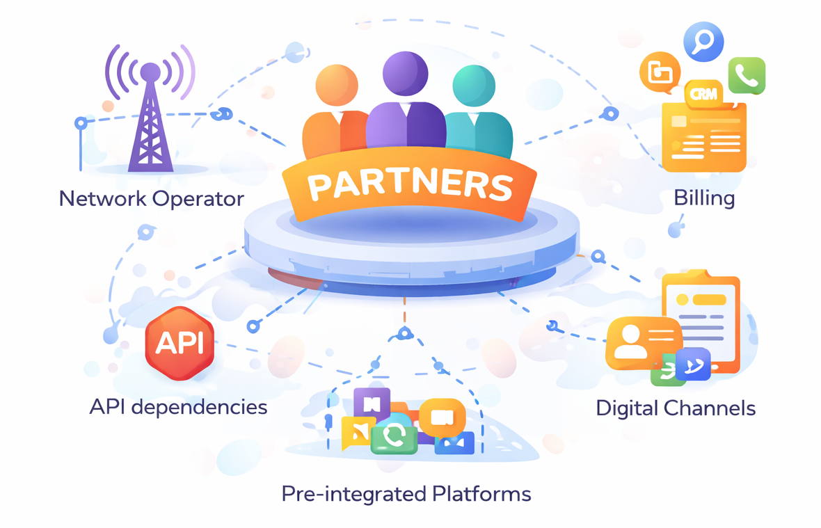
Pillar 2
Ecosystem, NOT Vendors
MVNOs need PARTNERS, not just providers/vendors
Multiple integrations
  Network operator
  Billing
  CRM
  Digital Channels
API dependencies
Pre-integrated platforms

Slide 8
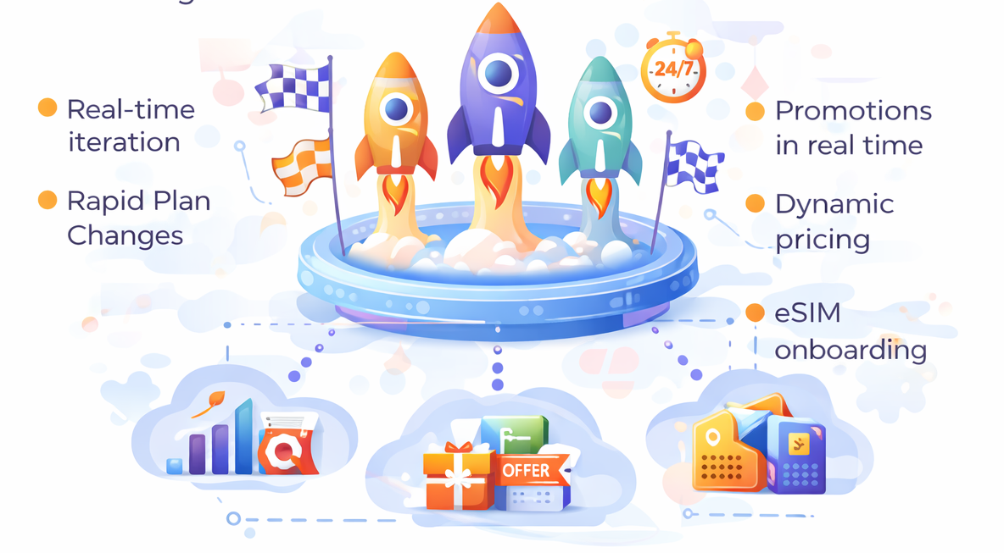
Pillar 3
Speed to Market & Iteration
Fast launches – then iterate
  Niche segments (ethnic, enterprise, cause, etc.)
  Digital-first brands
Real-time iteration
  Rapid Plan Changes
  Promotions in real time
  Dynamic pricing
  eSIM onboarding

Slide 9

Pillar 4
Data-Driven Growth
Real-time insights and analytics
Personalization
Customer lifecycle management
Churn reduction
Data is the Growth Engine – MVNOs must think like tech companies, not telcos.

Slide 10



It’s about CAPABILITY, not Tools!
Reframe tools beyond technology
NO JUST:
INSTEAD:
  Billing Platforms
  SIM Provisioning
  Automation
  Intelligence
  Integration
  Scalability
The right tools are the ones you don’t have to think about when you’re scaling

Slide 11
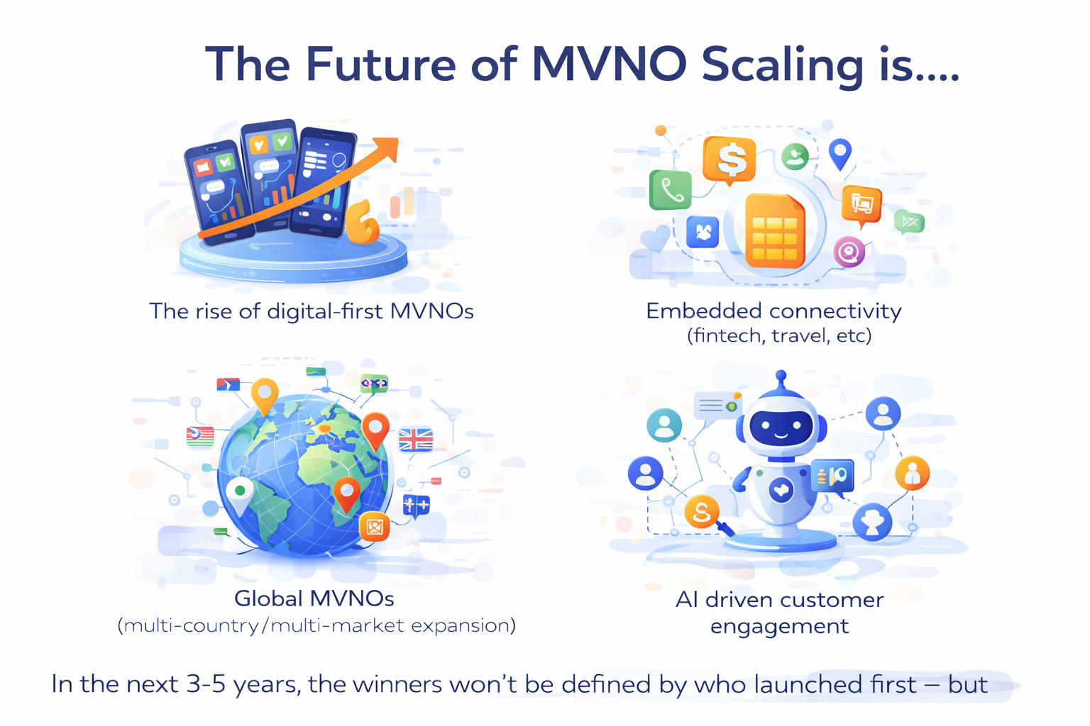
SCALE SMART or STALL!
The Future of MVNO Scaling is…..
In the next 3-5 years, the winners won’t be defined by who launched first – but by who scaled smartest”

Slide 12

THANK YOU!
Susan Sorensen
Plintron USA
Susan.sorensen@plintron.com

