Slide 1

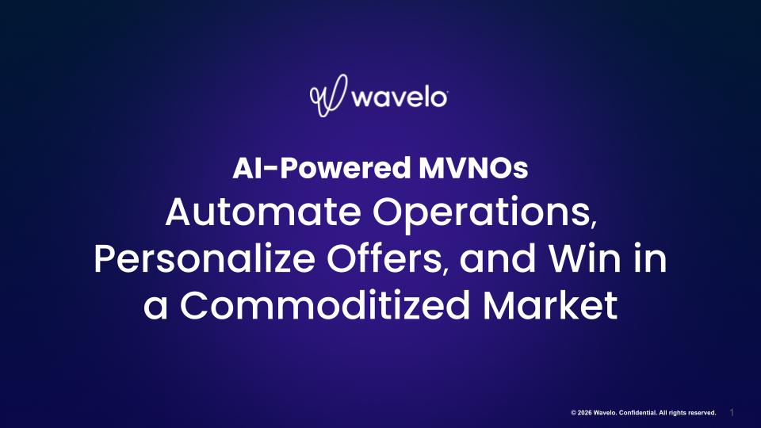
AI-Powered MVNOs
Automate Operations, Personalize Offers, and Win in a Commoditized Market

