Slide 1
Overview of the MVNO Market in Latin America
The good, the bad and the unexpected
MVNO Nation Americas 2026

Slide 2
23 Years of Consultancy
Helping MVNOs for more than 10 years
TELECO is your partner in business development in Latin America.
Market Studies
Business Models
Market
Business Plan
Feasibility Studies
Implementation Support
Regulation
Technology
Regulatory Evaluation
Grants and Taxation
eSIM, IoT, Satellite, Private Networks
Optical Networks, Submarine Cables, Data Center

Slide 3
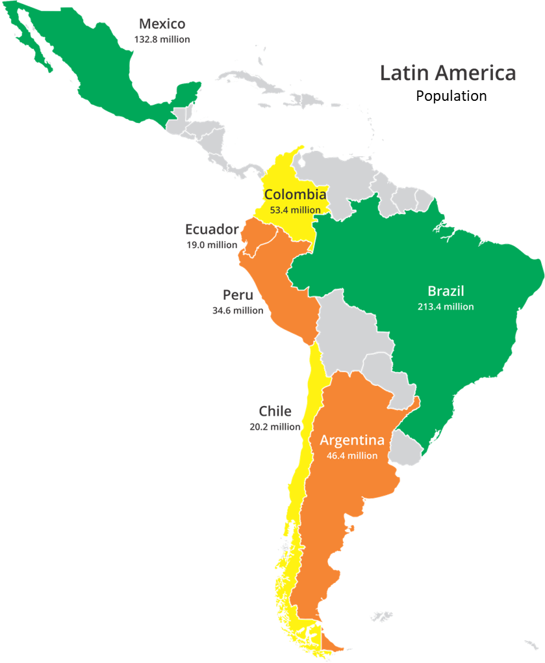
MVNOs in Latin America
 | 2025 | Mobile | MVNOs | Market Share
Advanced Mature model, active competition, reduced barriers | Brasil | 270 | 184 | 3,8%
 | México* | 142 | 30 | 10,4%
Intermediate Clear rules, but still a concentrated market. | Colombia | 78 | 7 | 2,0%
 | Chile | 31 | 7 | 0,8%
Initial Regulation exists, but participation is residual. | Peru | 38 | 11 | 0,3%
 | Argentina | 65 | 2 | -
 | Equator | 18 | 3 | -
*1Q25
The sale of Telefonica's operations in the region could contribute to the growth of MVNOs.

Slide 4
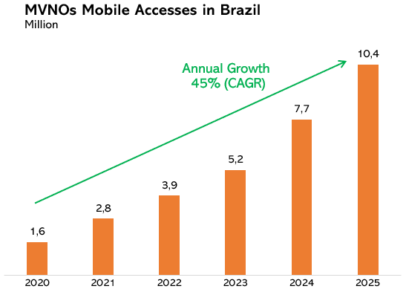
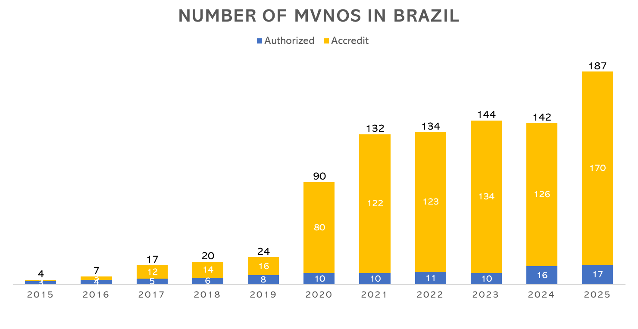
MVNOs in Brazil

Slide 5
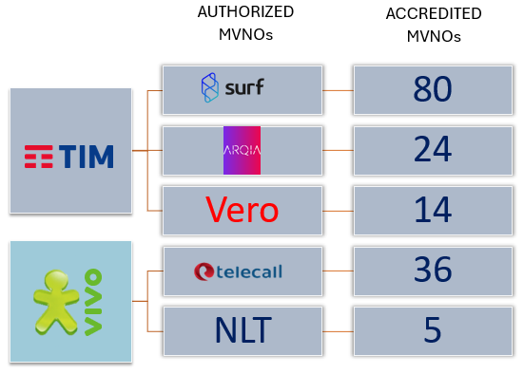
Brazil Regulation
Autorized
  Anatel license
  Same obligations as MNOs
  Response for invoice Accredit Costumers
  Usually, Full MVNO
Accredit
  Registration with Anatel
  Usually, Light MVNO
MNO can not own a MVNO
Anatel seeks to avoid interfering in the relationship between MNOs and MVNOs.
Issues: Exclusivity, Permanent Roaming, minimum monthly price per SIM card.
Claro had 3 accredited MVNO and Vivo 6.
There is also more then 100 brands.

Slide 6
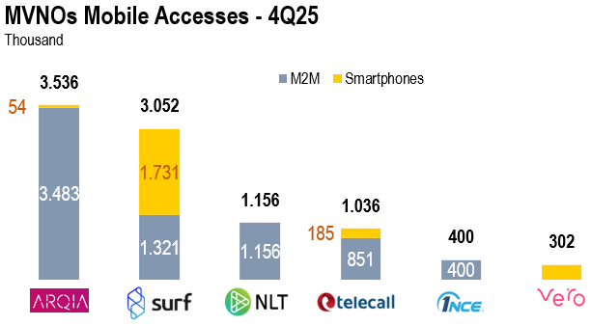
Main authorized MVNOs
MVNOs has a 25% market share of M2M for IoT:
  MVNOs have 25% market share
  70% of MVNO Accesses
MVNO for Persons
  Post
  ISPs (Combo)
  Ecosystem (Fintech, Magazines, …)
  B2B

Slide 7
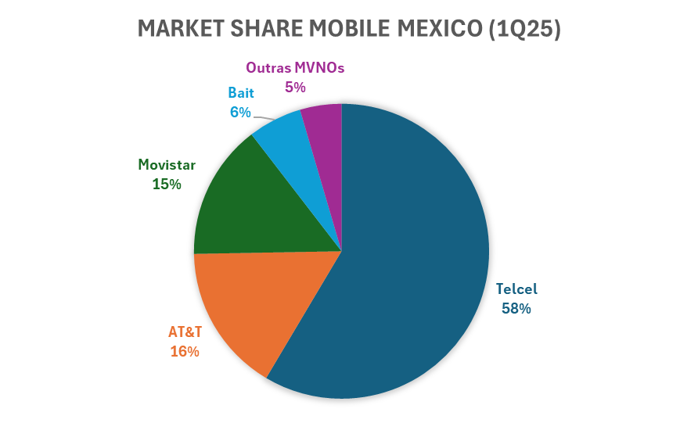
“Rede Cumpartida” boosted the growth of MVNOs in Mexico
Other MVNOs | Market Share
Fredompop | 1,5%
Megacable | 1,2%
Salinas | 0,6%
Televisa | 0,5%
NEWWW | 0,4%
Telmovil | 0,3%
Approximately 30 active MVNOs (22 reported in 1Q25).
Some MVNOs like FREEDOMPOP act as enablers.
83% Prepaid
The partnership between “Rede Cumpartida” and Bait makes it operate as an MNO.
Freedompop has Telcel as MNO.

Slide 8
Comparative Chart: Europe x Latin America
Feature | Europe (EU) | Latin America (Regional Average)
Regulatory Model | Harmonized (EU Guidelines) + National Implementation | Fragmented (each country with its own model)
Legal Basis | European Electronic Communications Code (EECC) | National laws
Licensing | Notification regime (generally without a specific license) | Authorization
Access Wholesale | Regulated via Significant Market Power | Direct negotiation or estate network (Mexico)

Slide 9
The key features and attractiveness of the Latin American MVNO market as a whole
Regulatory Landscape is different in each country:
  Advanced, Mature model, active competition, reduced barriers in Brazil and Mexico
  Intermediate Clear rules, but still a concentrated market in Colombia and Chile
  Initial, Regulation exists, but participation is residual in Peru, Argentina and Equator.
Having an initial MNO open to partnerships with MVNOs is key for the growth of MVNOs.
Usually, a Full MVNO act as an enabler for Light or Brand MVNOs.
IoT, ISPs, Fintechs, Supermarkets and B2B are niches with great potential for MVNOs.

Slide 10

Tks!
etude@teleco.com.br

