Slide 1

Transforming Nigeria’s
Telecom Market Through Innovation & Strategic Brand Collaboration
Daniel Upson – Group Partnerships Director
Notes:
Welcome everyone to this session on transforming Nigeria's telecom market. I'm Daniel Upson, Group Partnerships Director at Lebara. Today I'll walk you through why Nigeria represents one of the most exciting MVNO opportunities on the continent, and how Lebara is positioning itself to lead that charge. This is a personal passion area for me — partnerships are at the heart of how we make the MVNO model work in practice.

Slide 2

The Nigerian Telecom Opportunity
Nigeria is Africa’s largest telecom market with over 230 million people.
Connectivity is now central to commerce, education, entertainment and financial inclusion.
Despite high mobile penetration, affordability and digital inclusion gaps remain significant.
The next phase of telecom growth will be driven by innovation, partnerships and digital experiences.
Notes:
Let's start with the scale of the opportunity. Nigeria is Africa's largest telecom market by population — over 230 million people. Mobile connectivity isn't just a convenience here; it's the infrastructure layer for commerce, education, healthcare and financial services. But despite impressive penetration numbers, there are still significant affordability and inclusion gaps. That gap is exactly where MVNOs can play a decisive role.

Slide 3
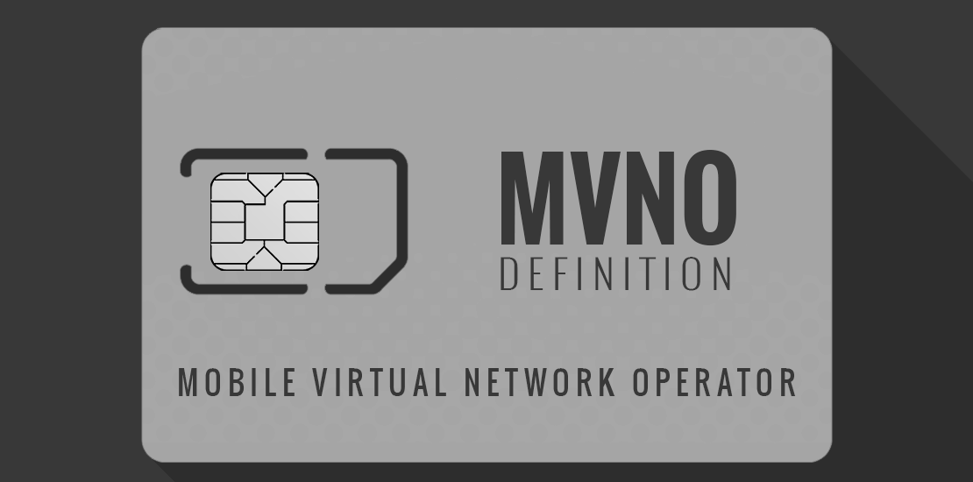
Why MVNOs Matter
MVNOs increase competition without duplicating expensive infrastructure.
They unlock innovation in customer experience, pricing and service delivery.
MVNOs are better positioned to target underserved customer segments.
Globally, MVNOs have reshaped telecom markets through agility and specialization.
Notes:
MVNOs are often misunderstood as simply resellers. They're not. Done well, an MVNO is an innovation platform. We don't duplicate the billions spent on towers and spectrum — we build on top of that infrastructure and compete on customer experience, pricing intelligence and digital services. Globally, the markets where MVNOs have flourished — the UK, Europe, US — are also the markets with the most dynamic consumer telecom innovation.

Slide 4
Nigeria’s MVNO Moment
The NCC MVNO framework marks a transformational phase for the industry.
It opens the market for innovation-led operators and digital ecosystems.
The opportunity extends beyond airtime into fintech, identity and digital commerce.
Nigeria is positioned to become Africa’s leading MVNO innovation market.
MVNO
Notes:
2024 and 2025 have been watershed years for Nigeria's MVNO sector. The NCC's framework has moved from aspiration to reality. And critically, the opportunity isn't just to launch another SIM card. The MVNO licence opens the door to fintech integration, digital identity, and commerce ecosystems built on top of the connectivity layer. Nigeria has the right ingredients to become the benchmark for MVNO innovation across the continent.

Slide 5

From Infrastructure to Experience
Telecom competition is evolving from infrastructure dominance to customer experience leadership.
Future operators must combine connectivity with digital intelligence and personalization.
Consumers increasingly demand seamless digital onboarding and self-service experiences.
Success will depend on agility, analytics and ecosystem partnerships.
Notes:
I want to make a broader point here about where telecom competition is heading. Infrastructure build-out is largely a solved problem for the major MNOs. The next battleground is customer experience — seamless onboarding, self-service, personalisation, and digital-first engagement. For an agile MVNO, this is home turf. We can move faster, test and iterate, and build the kind of consumer relationships that legacy operators struggle to replicate.

Slide 6

Strong brands accelerate trust and customer acquisition.
Global partnerships bring operational expertise, credibility and technology transfer.
Strategic collaboration allows operators to scale beyond connectivity.
Telecom is increasingly becoming an ecosystem business rather than a standalone utility.
The Power of Strategic Brand Collaboration
Notes:
At Lebara Group, we've built our model around the power of brand and strategic partnership. A strong brand accelerates trust — particularly important when you're reaching diaspora communities or mobile-first consumers who are sceptical of telecom providers. Our partnerships bring operational playbooks, technology transfer and credibility. The key insight is that telecom has become an ecosystem business — you can't win alone.

Slide 7

Lebara Nigeria is among the first Tier 5 MVNO opportunities within the Nigerian market.
The model combines global telecom experience with local market execution.
Focus areas include affordability, diaspora connectivity and digital onboarding.
The objective is to build a digital-first telecom platform for modern African consumers.
Lebara Nigeria
A Local Case Study
Notes:
Let me bring this to life with Lebara Nigeria specifically. We are among the first Tier 5 MVNO licences in the Nigerian market. Our proposition is built around three pillars: affordability for the mass market, diaspora connectivity linking the Nigerian community globally, and a digital-first onboarding experience. We're not trying to out-infrastructure the MNOs. We're building a digital telecom platform for how Nigerians actually live and connect today.

Slide 8

Digital-First Telecom is the Future
eSIM adoption, AI support and embedded finance are reshaping telecom consumption.
Consumers increasingly expect mobile-first, frictionless digital engagement.
The next generation telecom operator must operate like a technology company.
MVNOs are structurally positioned to adapt faster to market evolution.
Notes:
The technology landscape is moving fast and in our favour. eSIM adoption removes the friction of physical SIM distribution — critical for reaching consumers quickly at scale. AI-powered support reduces our cost to serve. Embedded finance means we can build financial services directly into the connectivity experience. The next generation telecom operator looks more like a technology company than a traditional carrier — and that's exactly the model we're building.

Slide 9

Unlocking New Revenue Ecosystems
Future telecom revenues extend beyond voice and data.
Opportunities include fintech, travel eSIMs, APIs, entertainment and enterprise services.
Strategic partnerships create recurring digital revenue streams.
Telecom operators are evolving into broader digital service platforms.
Notes:
Voice and data revenue alone won't define the winners of the next decade. We're building revenue streams across fintech, travel eSIMs, enterprise APIs, and entertainment partnerships. Strategic partnerships are the unlock here — each collaboration extends our reach and creates recurring revenue outside the traditional ARPU model. Think of us as a digital services platform that happens to provide connectivity, not the other way round.

Slide 10
Challenges the Industry Must Solve
Wholesale pricing must support sustainable MVNO economics.
Regulatory consistency remains essential for long-term investor confidence.
Operators must balance innovation with disciplined execution and profitability.
Collaboration between regulators, MNOs and MVNOs will determine industry success.
Notes:
I want to be honest about the challenges — because they're real. Wholesale pricing from host MNOs needs to support sustainable economics; if the margin isn't there, the innovation won't follow. Regulatory consistency is essential for attracting the long-term investment this market deserves. And as operators, we must balance our ambition for innovation with disciplined execution. The industry succeeds when regulators, MNOs and MVNOs are aligned on the shared prize.

Slide 11

What Success Looks Like for Nigeria
Greater affordability and digital inclusion.
More innovation-led competition.
Expansion of digital jobs and entrepreneurship opportunities.
Deeper integration between telecom, fintech and commerce ecosystems.
Acceleration of Nigeria’s digital economy ambitions.
Notes:
When I think about what success looks like for Nigeria, it's not just about Lebara or any single operator. It's about what a thriving MVNO ecosystem delivers for consumers and the broader economy — more affordable connectivity, more competition driving better services, digital jobs, and a platform for Nigeria's fintech and commerce sectors to reach more people. That's the ambition we're all here to work towards.

Slide 12

The African Opportunity
Africa has the opportunity to build uniquely African telecom innovation models.
MVNOs can drive inclusion, youth empowerment and economic participation.
Nigeria has the scale and market depth to lead this transformation.
The continent’s telecom future will be shaped by innovation and collaboration.
Notes:
I want to zoom out and make a continental point. Africa doesn't need to copy the Western MVNO playbook. There is an opportunity to build something uniquely African — MVNO models designed for mobile money integration, for diaspora connectivity, for youth-first digital experiences. Nigeria, given its scale and market depth, is the natural place for that innovation to start. What we build here will shape the template for the rest of the continent.

Slide 13

The future of telecom belongs to agile, collaborative and digitally intelligent operators.
MVNO innovation can redefine connectivity access across Africa.
Strategic partnerships will become as important as network infrastructure.
The opportunity is not simply to build networks — but to build digital ecosystems that empower millions.
Notes:
To close — the future of telecom belongs to operators who are agile, collaborative and digitally intelligent. Infrastructure matters, but it's table stakes. The operators who win will be the ones who build ecosystems — who connect people not just to a network, but to financial services, to opportunity, to each other. That's what the MVNO model, done right, can deliver. And that's why I'm genuinely excited about what we're building in Nigeria.

Slide 14
Thank You
Daniel Upson
Group Partnerships Director, Lebara Group
Transforming Connectivity Through Innovation & Collaboration
Daniel Upson
Notes:
Thank you for your time today. I'm very happy to take questions — whether on the Lebara Nigeria model specifically, on the partnership frameworks we use at Group level, or on the broader market dynamics.

