Slide 1

Partnering with MVNOs Beyond Mobile
Fiber, Fixed Wireless & Further Afield
Brad Mostert
Head of AirMobile Wholesale
Presented at
MVNO Nation Africa
June 2026

Slide 2



Afrihost
South African Internet Service Provider
MVNO
Fibre
DSL
Fixed Wireless
VOIP
Satellite (soon)
Shared Hosting
Cloud
Colocation
Domains
Email
(40 FNOs)
(4 MNOs)

Slide 3
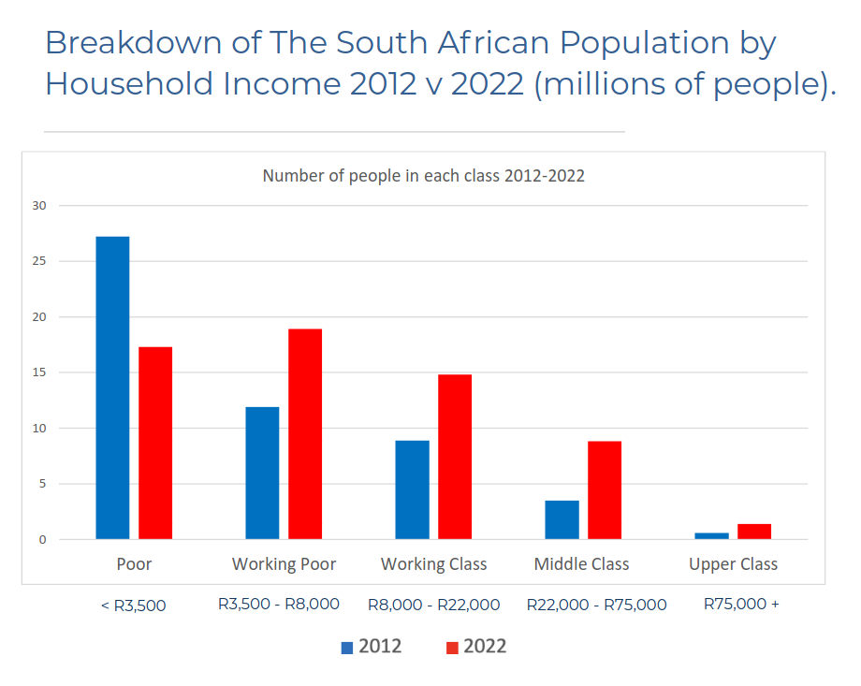
South African Landscape
Egan, P. & Lappeman, J. (2024). Social Mobility in South Africa: An overview of the
consumer landscape on the 30th anniversary of South Africa’s democracy. UCT liberty institute of strategic marketing.
(StatsSA, GHS, 2022)

Slide 4
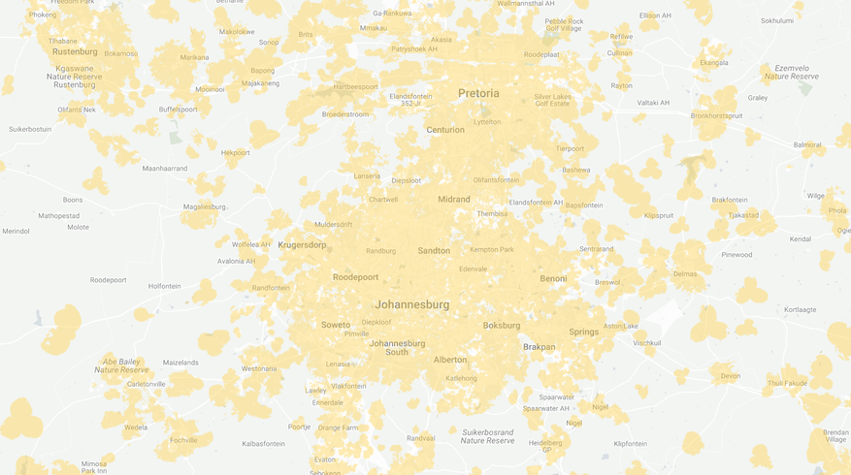
Data for the Household
Low Income, High Density Areas
Low Income Fibre
Fixed Wireless
  Vuma Reach
  FTTH to Households in the R5k to R30k income range
  4.8mil Households (1mil passed, 300+k connected)
  Prepaid or Monthly
  More Payment Options
  Slightly Lower Price-point
  Sold via Partnered ISPs
  Large Caps (or Uncapped) at low price
  Locked to a Location
  Specific Devices
  Want more than 1 Network
(Also Openserve OPPC, Frogfoot Rise, MetroConnect, Zoom Flex, and others)

Slide 5
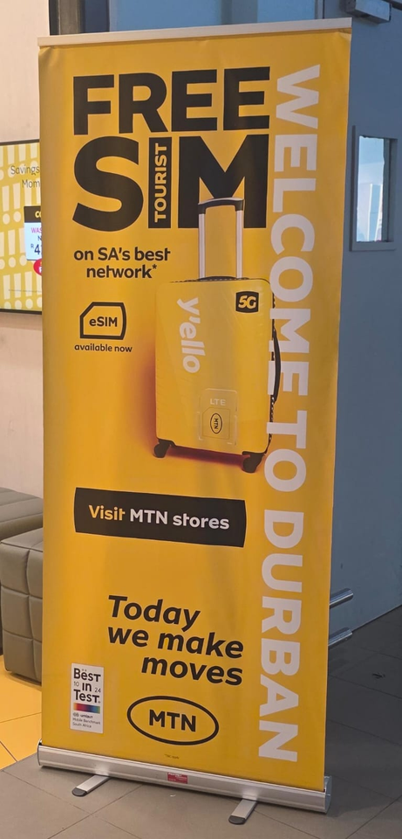
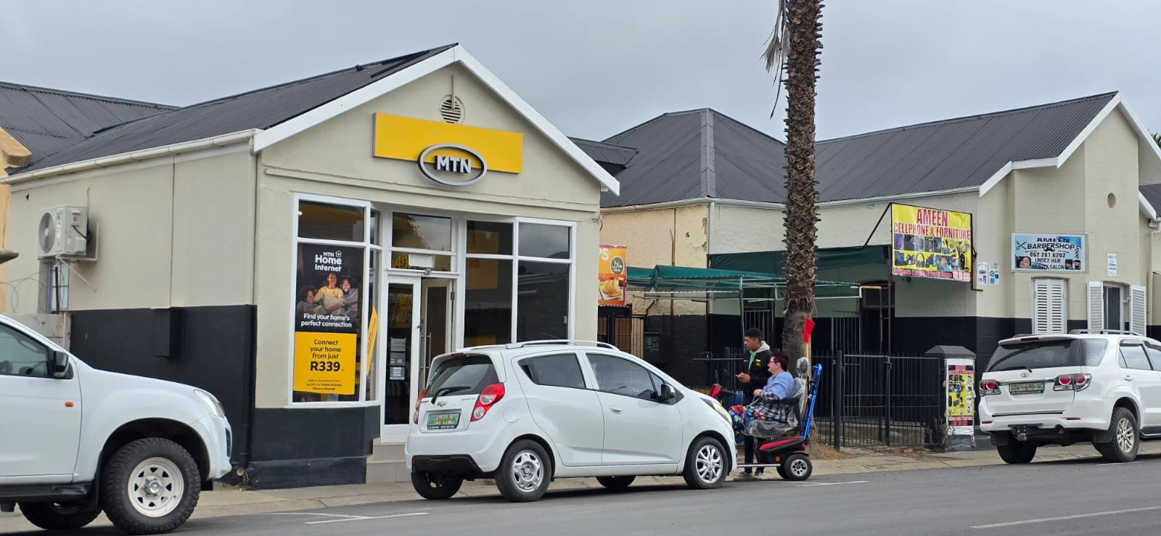
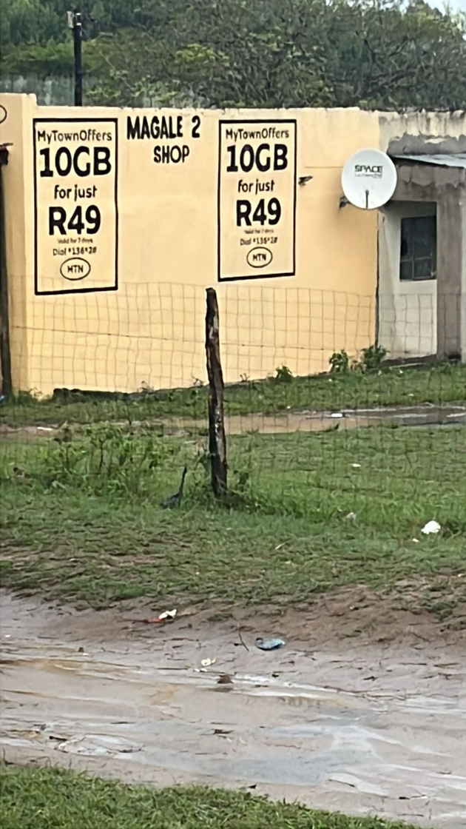
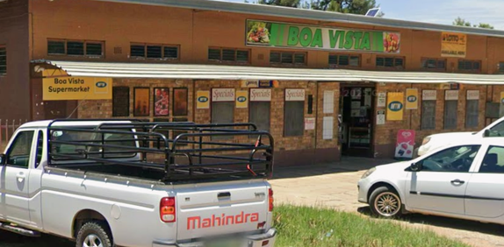

What the MNOs are Doing
Calvinia, April 2026
King Shaka Airport,
May 2026
Hertzogville,2025
R22 outside Manguzi, January 2026

Slide 6

Data for the Household
Low Income, High Density Areas
Desirable to MVNO
  Sold to Decision Maker of Household
  Longer Lifetime than Prepaid SIM
  Newer Market
How an ISP Can Help
  Support Heavy Industry
  Different Technologies to Mobile
  Consistency across bundled products
  Online vs Offline Charging
  Breakout, Re-Rating, Reverse Billing

Slide 7
Further Afield
Domains?
“... compared to previous recessions, potential entrepreneurs now have more widely available broadband, greater digital fluency, and a more mature e-commerce marketplace ...”
World Economic Forum Article entitled “Why microbusinesses are booming in the US” based on GoDaddy Venture Forward data covering COVID-era spike, 2021
https://www.weforum.org/stories/2022/01/microbusinesses-flourished-during-the-pandemic-now-we-must-tap-into-their-full-potential/

