Slide 1

Scaling 3X in 36 Months
How AI, Influencers, and Leadership Are Transforming MVNO Growth
Saúl Armando Soltero / CEO of Bromóvil
MIAMI · MVNO NATION 2026

Slide 2
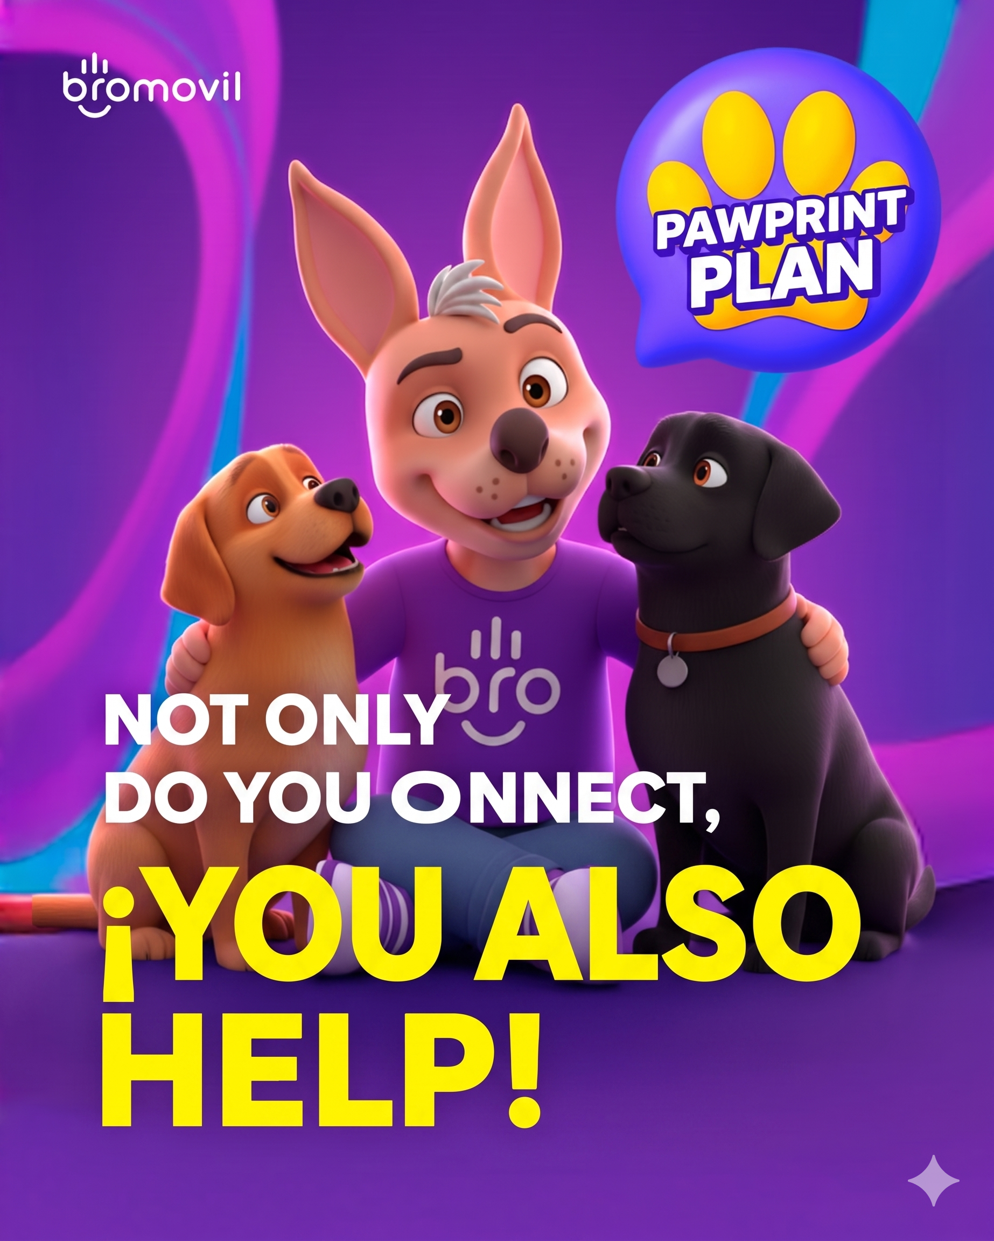
WHAT IS BROMÓVIL?
A purpose-driven MVNO from Mexico.
With every recharge, our customers help us:
🐾
RESCUE
abandoned dogs across Mexico
❤
HEAL & CARE
vet treatment, vaccines, food
🏠
ADOPT
connecting them with loving families
Not only do you connect — you also help.

Slide 3

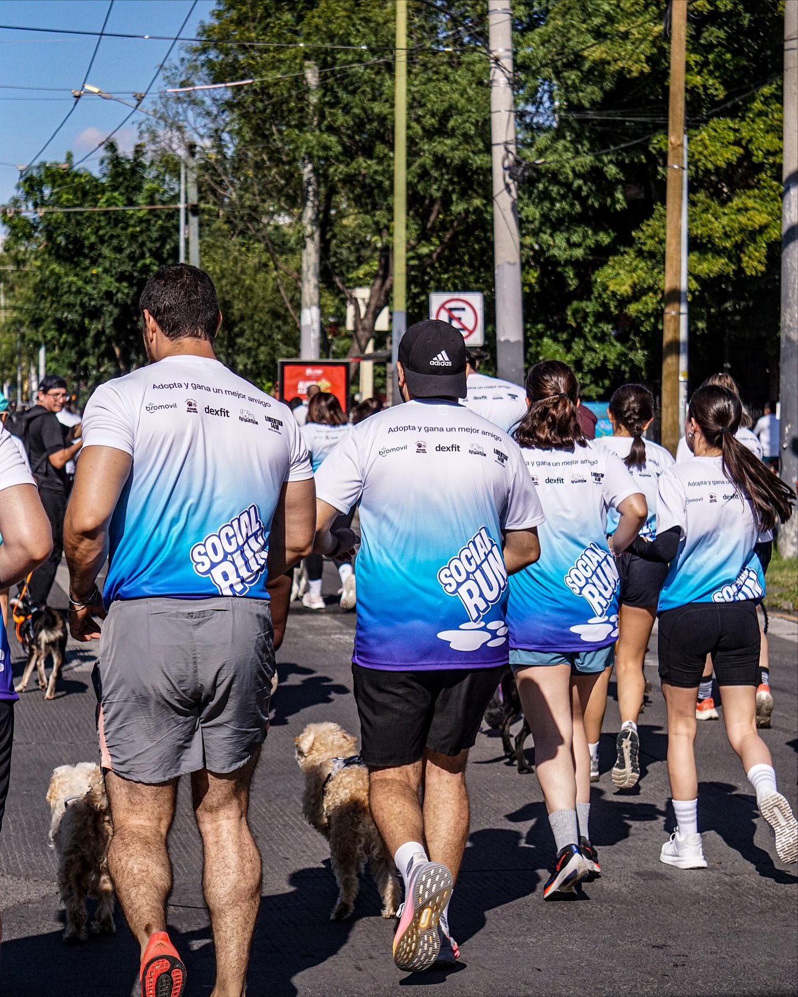

Slide 4

THE FACTS
3X
HOW WE DID IT
1
AI
60+ activities across our operation
2
INFLUENCERS
revenue growth
micro to big — built on trust, not budget
in just 36 months.
3
LEADERSHIP
the differentiator that scales everything
bromovil.com

Slide 5
ACCELERATOR #1
AI is not a tool.
It's a MULTIPLIER.
The companies winning today don't just "use" AI —
they integrate it into every single decision.

Slide 6
AI TOOLS WE'RE USING IN 2026
The stack that's actually moving the needle.
📈
Marketing & Content
🎬
Video & Creative
Claude · ChatGPT · Gemini · Jasper · Perplexity
VEED · Canva AI · Runway · Nano Banana · Creatify
💬
Customer Service
💼
Sales & CRM
Intercom Fin · Zendesk AI · Tidio Lyro · Hiver
HubSpot Breeze · Salesforce Einstein · Drift
📊
Data & Analytics
⚡
Agents & Automation
Looker · Power BI Copilot · Brandwatch · Gumloop
Claude Code · n8n · Zapier AI · Make
Test. Learn. Iterate. Don't try to use them all on day one.
bromovil.com

Slide 7
OUR SECOND WEAPON
Influencers — without breaking the bank.
1
2
3
Ambassadors,
not one-night stands
Commissions,
not paychecks
Co-create,
don't brief
Long-term influencers truly committed to the brand.
Free service, perks or commission per new customer.
Our top performer earned $50K last year — with skin in the game.
Don't say 'here's the script.' Say: how would you recommend us to your best friend?
Akim Aguilar didn't sell Bromóvil. He used it. And that beats 10 flashy ads.
bromovil.com

Slide 8
CASE STUDY
Akim Aguilar
Mexican content creator · 500K+ followers
We didn't hand him a script.
We asked one question:
"How would you recommend Bromóvil to your best friend?"
He didn't sell Bromóvil. He used it.
And that beats 10 flashy ads.
bromovil.com

Slide 9
THE TRUTH
AI and influencers don't scale companies.
People do.
And people scale through one thing: leadership.
People don't quit companies — they quit leadership.

Slide 10
THE REAL DIFFERENTIATOR
AI + influencers without leadership =
a smartphone without a charger.
THE 4 KEYS TO LEADERSHIP FOR SCALING
01
Find your Mission
02
Build Resilience
What change are you bringing — beyond profit?
There will be bumps in the road. Lots of them.
03
Learn Endlessly
04
Lead with Attitude, Not Ego
Thinking you know everything = the moment you become obsolete.
One inspires. The other isolates.

Slide 11

🎬
If your MVNO were a movie...
What does the soundtrack of your office sound like?
Because your leadership is that soundtrack.
YOU ARE THE DIRECTOR.

Slide 12


What does your leadership style look like?

Slide 13

What does your leadership style look like?

Slide 14

What does your leadership style look like?

Slide 15

What does your leadership style look like?

Slide 16
THE TAKEAWAY
AI gives you
Influencers give you
Leadership gives you
SPEED
REACH
MEANING
People don't follow technology.
They follow meaning.
Your repetition is your reputation. Do it with purpose.
Thank you, Miami! · ¡Gracias! · LinkedIn: Saúl Armando Soltero

