Slide 1


COMPETITIVE RESILIENCE:
The transformation of the Small and medium-sized ICTs
Ariel Fernández Alvarado
April 2026

Slide 2
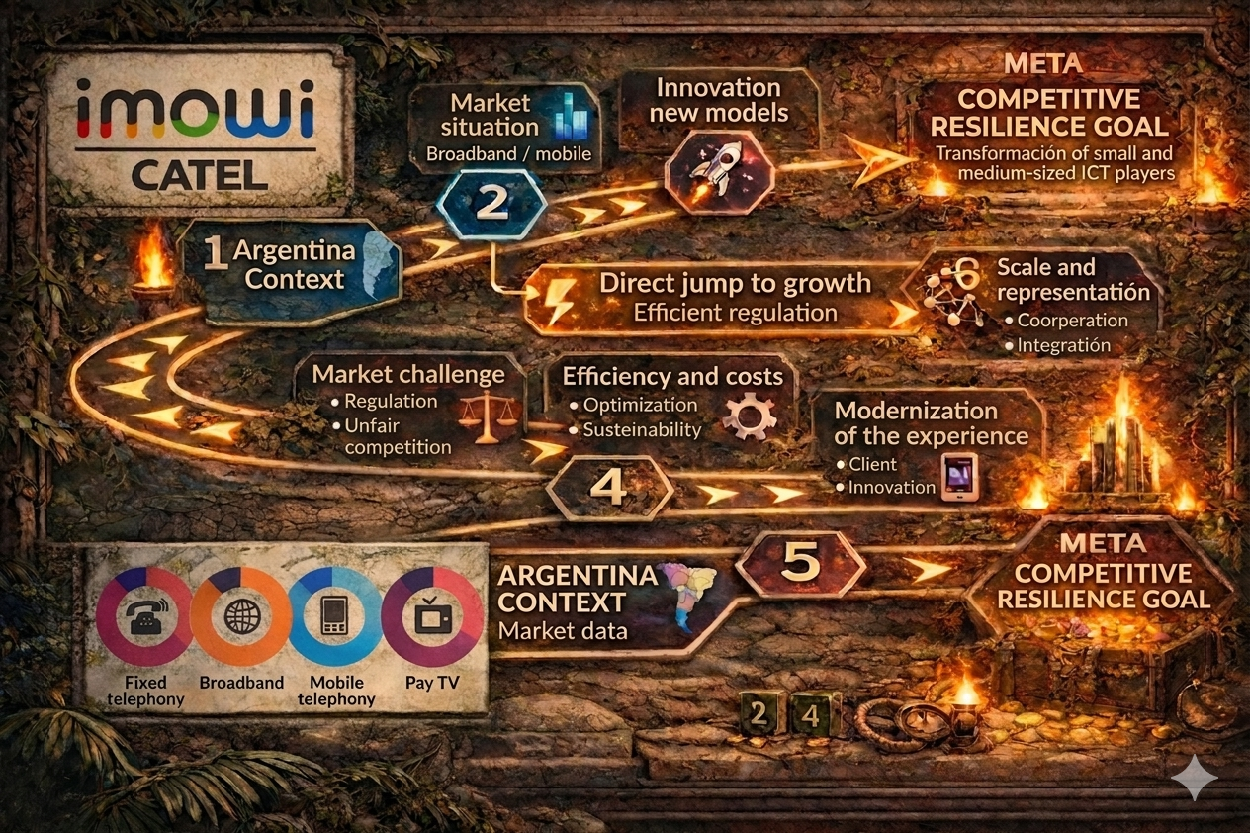

Slide 3

Visibility and Relevance
Technological innovation and
new business models
Policy and regulation
From Argentina, with a view to Latin America and the world.

Slide 4




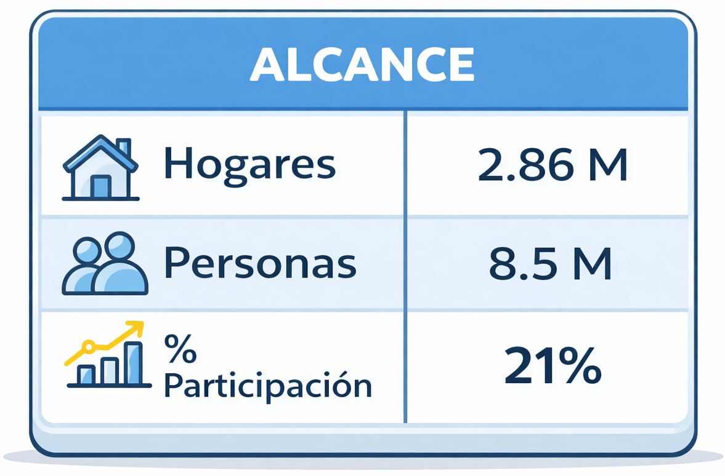
Argentina
46 million inhabitants
17 million households
Broadband access
Mobile lines
13.6 million households – 80% penetration
63.2 million – 135% penetration

Slide 5
COMPETITIVE RESILIENCE:
The transformation of the Small and medium-sized ICTs
Clear rules and a present regulatory body
Cost efficiency with growth
Modernizing the experience
Competitive strategy. The quadruple play

Slide 6
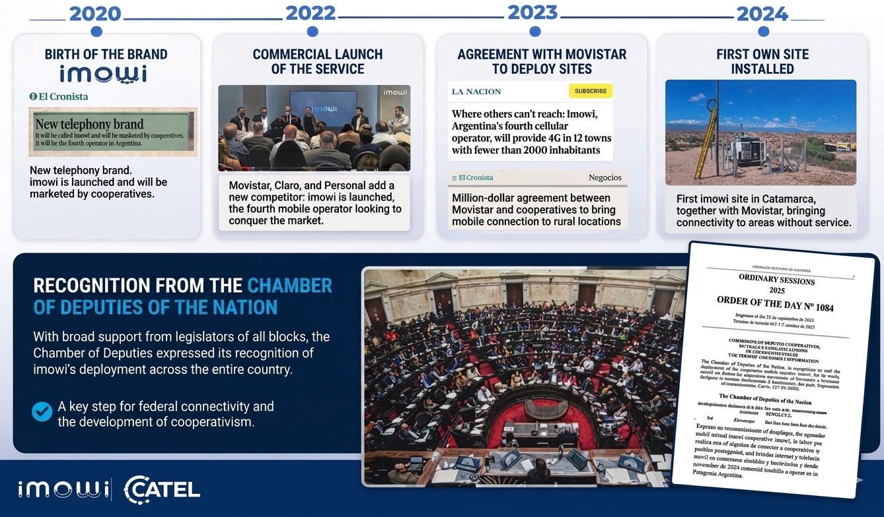
THE EVOLUTION OF IMOWI

Slide 7
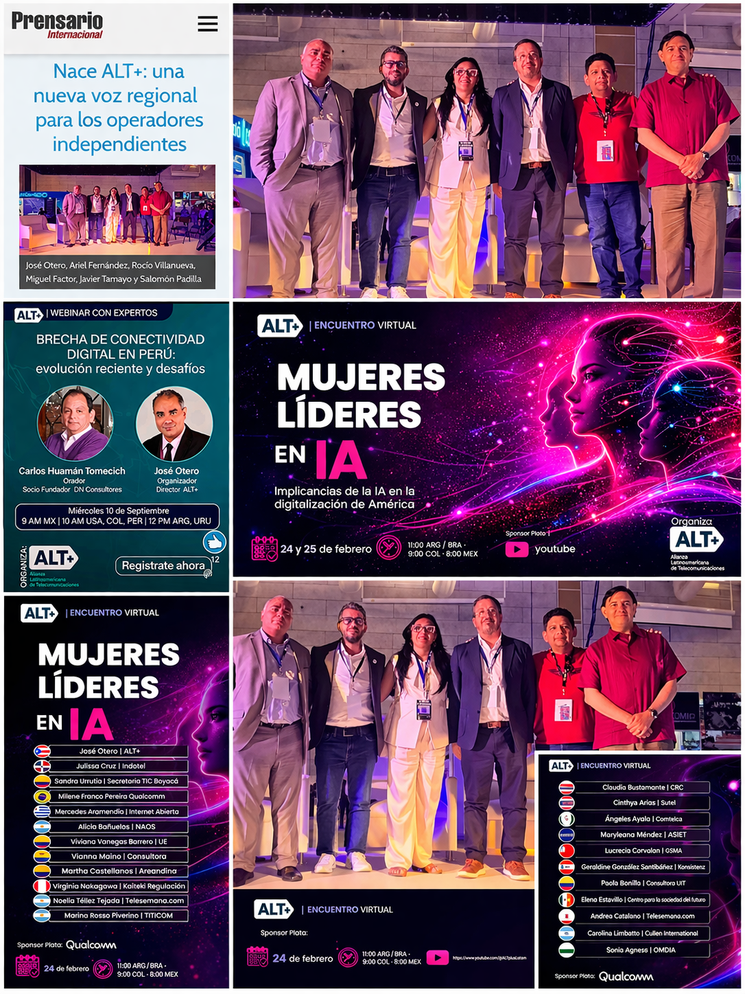

SCALE, REPRESENTATION AND REGIONALIZATION of independent operators

Slide 8
Thank you!

Slide 9


